Slide 1
The Secret Life
of Forms
Ivan Wilson
Innate
CSS Dev Conference
San Antonio, Texas
October 17-19, 2016
Notes:
1
Greetings/additional statements - Title

Slide 2
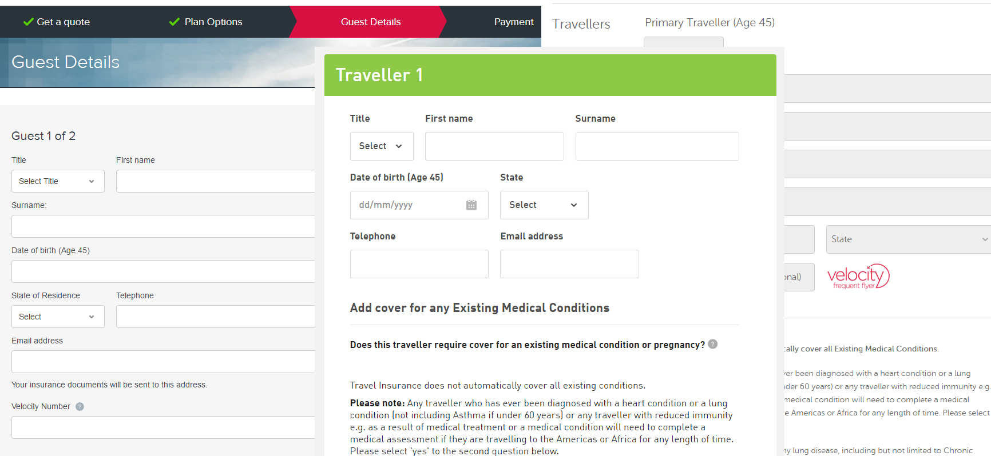
Notes:
2
Stack of forms – financial (house/loans), government programs, shopping carts
Question to audience – What is the most important thing you did that involved an online form (doesn’t have to be a purchase)?

Slide 3
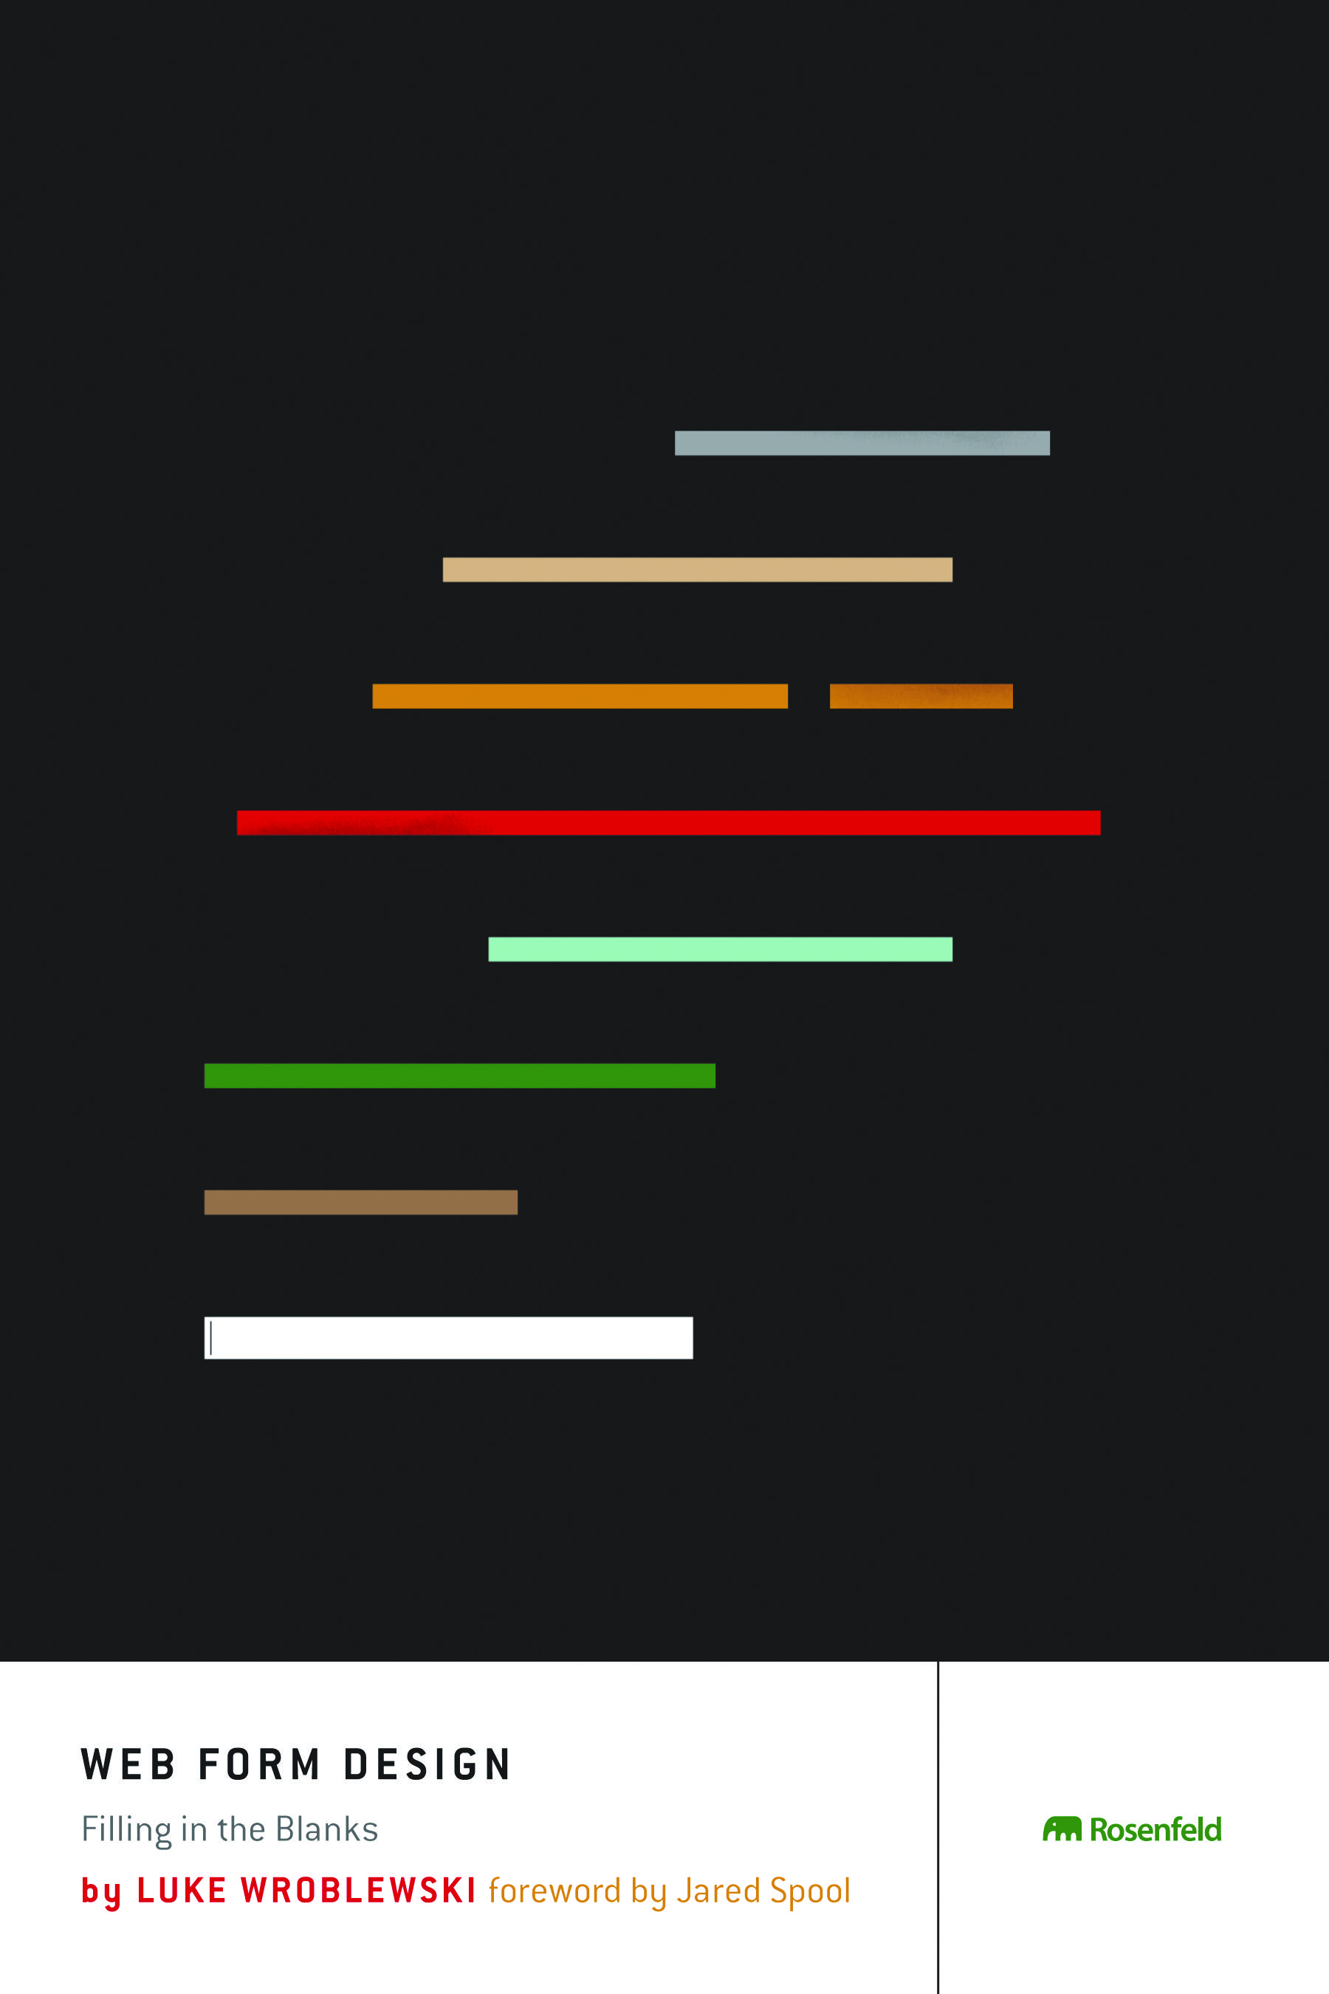
Notes:
3
How do we design forms to work best? What are the best patterns/ones that work the best? Well know book by Luke Wroblewski

Slide 4
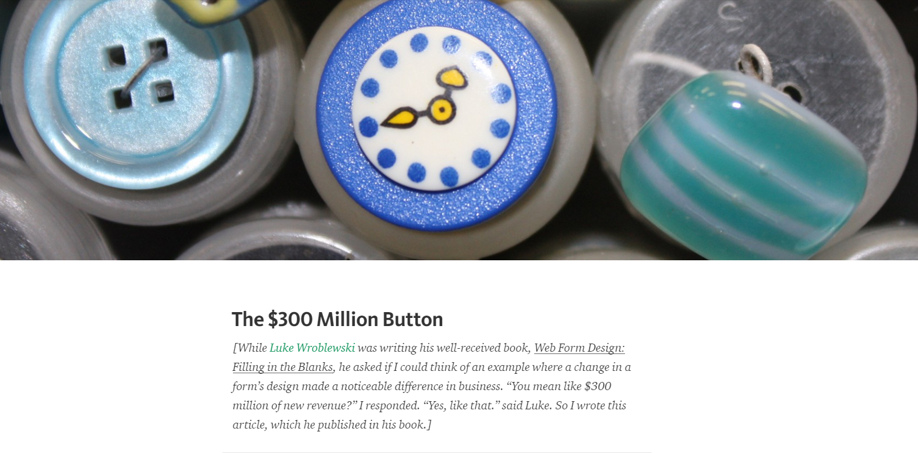
Notes:
4
$300 Million Button story – referencing more UX
Needless to say, we have a lot of work around the experience of using/building forms. Unfortunately, reality says otherwise. (no shaming)
But forms aren’t just about data entry. Lots of stuff can be done with forms that we don’t think about.

Slide 5
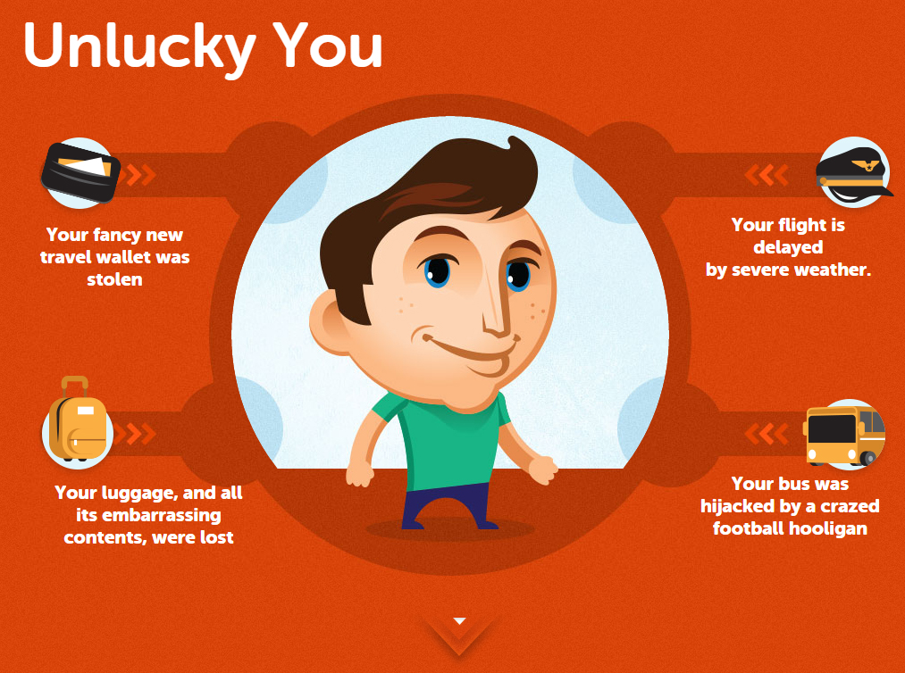
Notes:
5
Project youGo – form used as demo/animation
(Go to http://yougotravelinsurance.com.au/, use the following slides as backup) Travel insurance – funny demo displaying bad things happening on a vacation
Cute animations (Rachel would love this ☺)

Slide 6
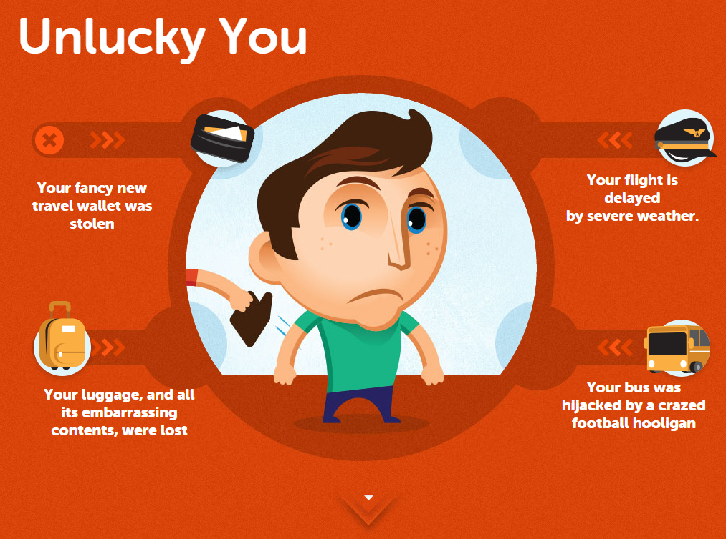
Notes:
6

Slide 7
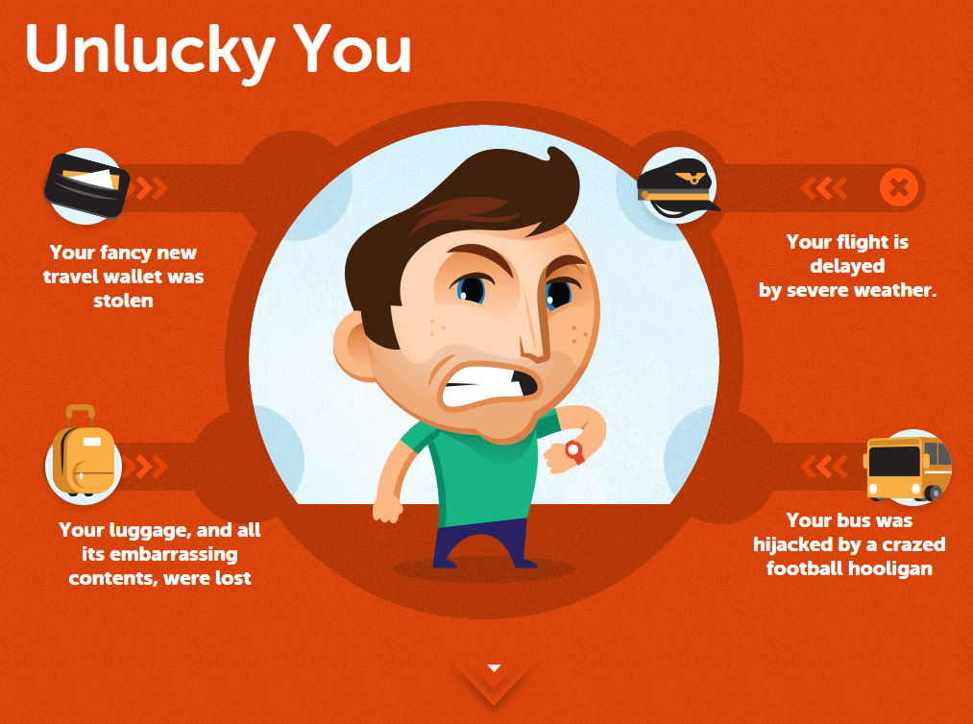
Notes:
7

Slide 8
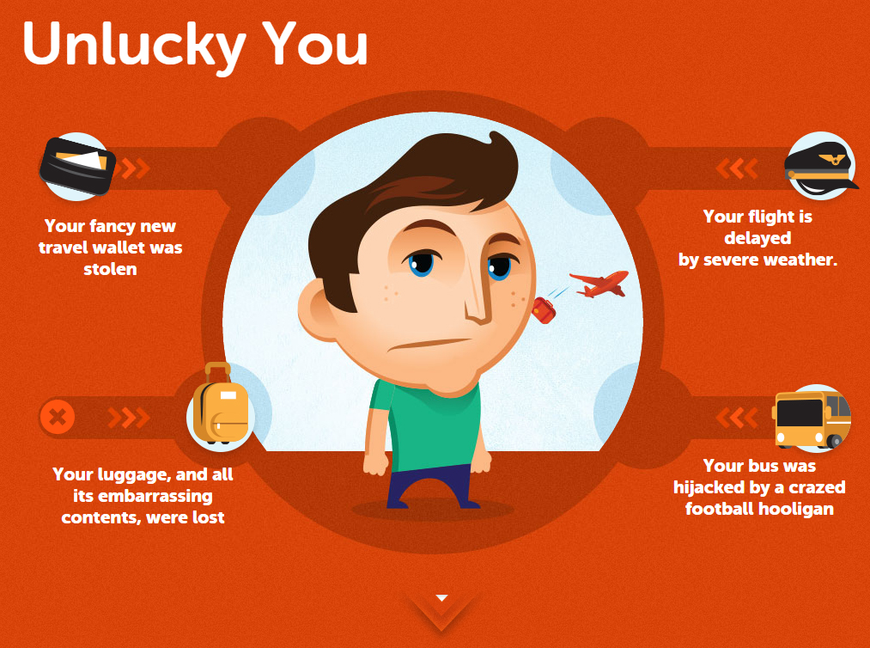
Notes:
8

Slide 9
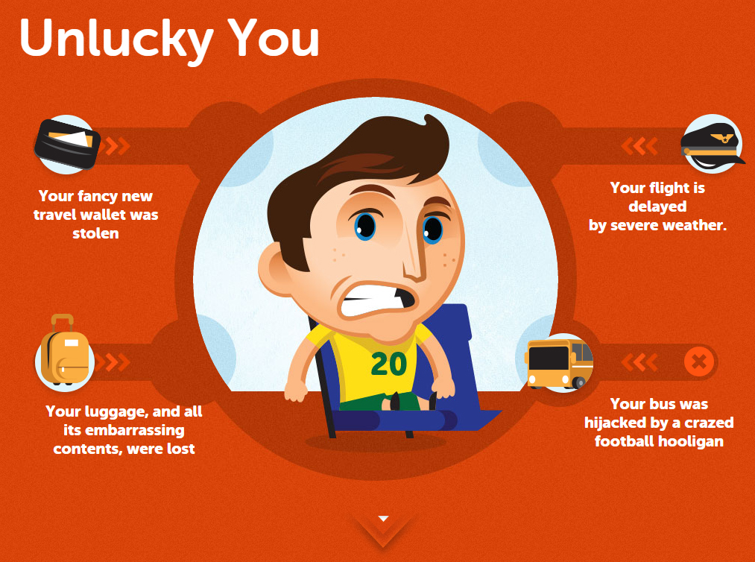
Notes:
9

Slide 10
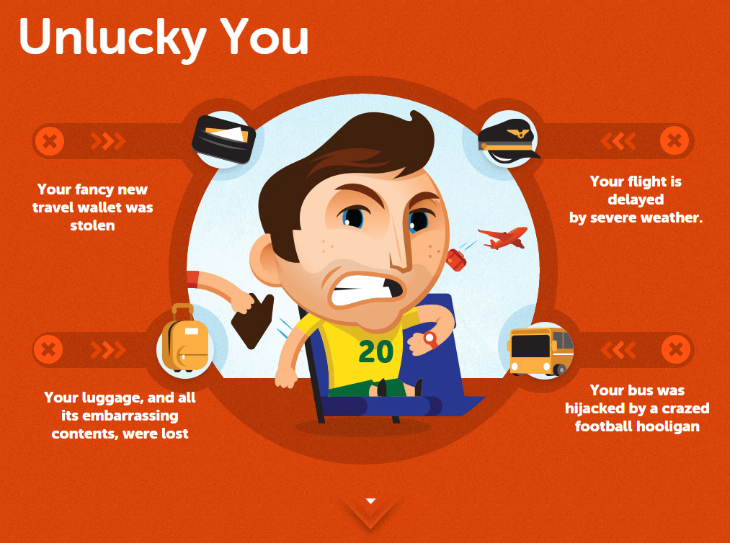
Notes:
10
(If you have all four – I don’t want to be around you during my vacation ☺)
I’ll get back to this later.
Anyways, let me start over with the introduction…

Slide 11

Notes:
11
My name is Ivan Wilson, FED at Innate, a digital agency

Slide 12

Notes:
(Innate location) In Washington, DC (national capital) in Dupont Circle district
12

Slide 13
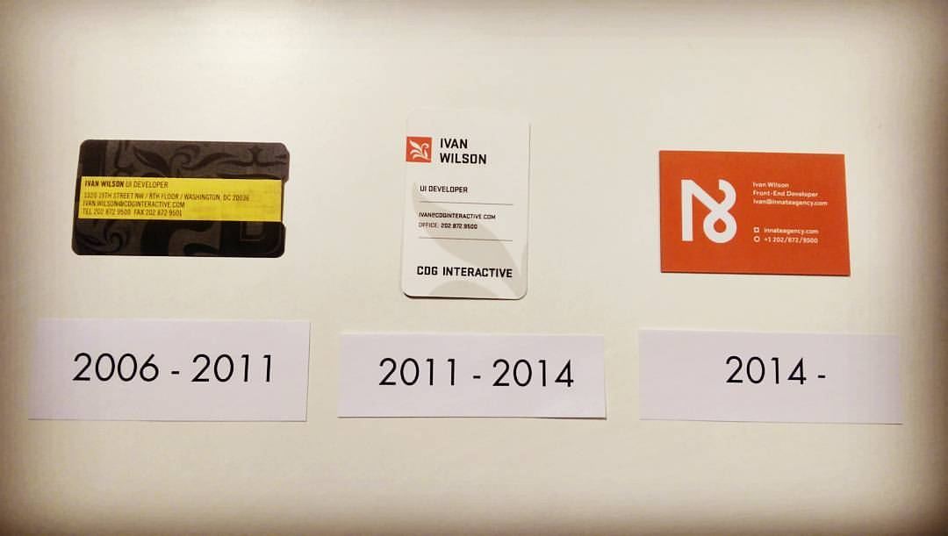
Notes:
13
10th Anniversary in April

Slide 14

Travel Insurance
Notes:
14
Travel Insurance
What is travel insurance? (Ask audience)

Slide 15
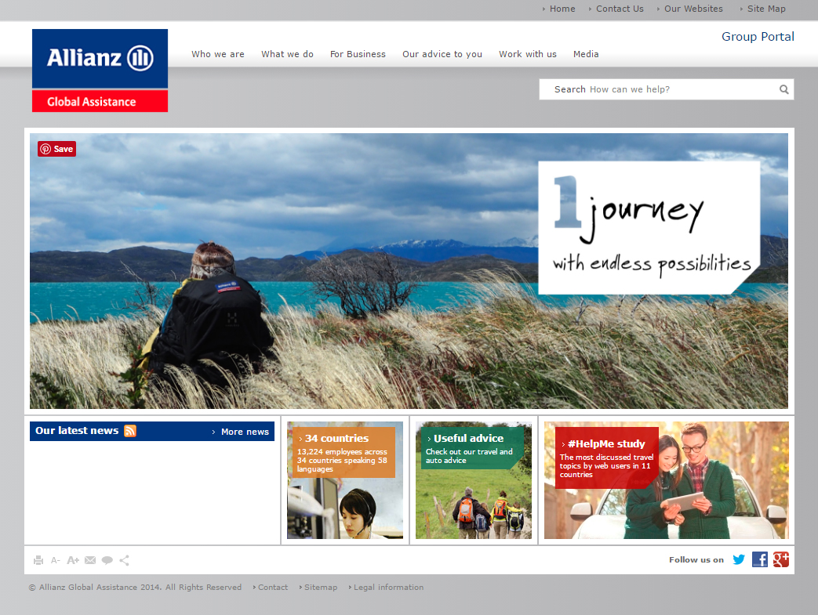
Notes:
Mondial Assistance/Allianz (2008-2012)
15

Slide 16

Notes:
16
Cover-More (2012 -)
Australia, NZ, UK, China, (India?) and recently to US

Slide 17
Notes:
17
Explain experience with forms/job
Data
Policies
eCommerce
Some good/bad

Slide 18
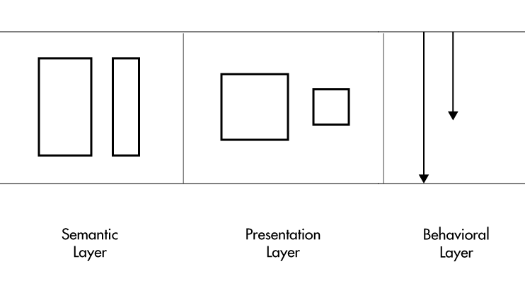
HTML
CSS
JS/ARIA
Notes:
Referencing Project Ottawa – three layers, translated into a) HTML, b) CSS, c) JS/ARIA
The FED toolbox for building experiences.
18

Slide 19
HTML
Notes:
Referencing Project Ottawa – three layers, translated into a) HTML, b) CSS, c) JS/ARIA
The FED toolbox for building experiences.
19

Slide 20
HTML is not
a construct.
Notes:
20

Slide 21
HTML is not
a construct.
It‘s a language.
Notes:
21

Slide 22
HTML is not
a construct.
It‘s a language.
And it has
Notes:
22

Slide 23
HTML is not
a construct.
It‘s a language.
And it has
superpowers.
Notes:
23
What sort of superpowers?

Slide 24
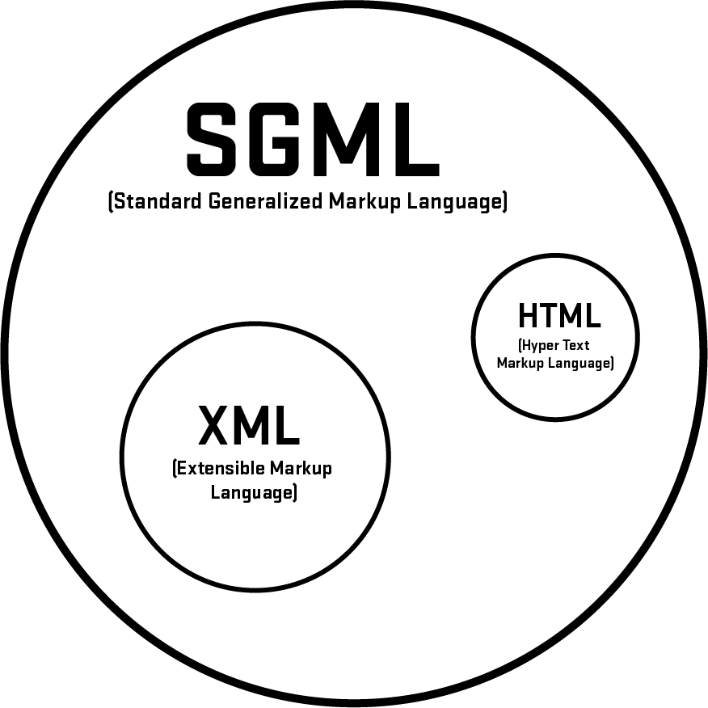
Notes:
Diversion – History of HTML
Reminders – Tim, markup, HTML, XML
SGML – 30th anniversary, WWW – 25th anniversary
(No. You don’t want to read SGML.)
HTML – more relaxed, checkered past cousin of XML
Basic to forms…
24

Slide 25
HTML inputs (pre HTML5)

Slide 26
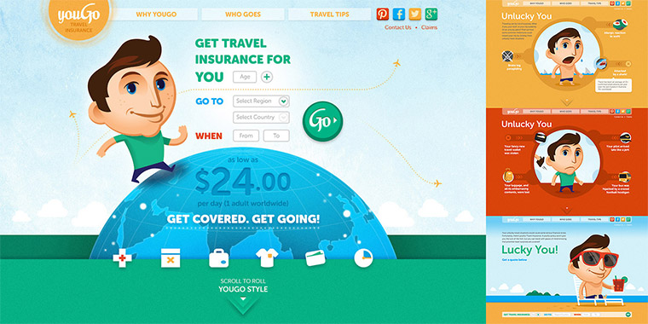
Notes:
youGo – travel insurance for under 30 crowd/Cover-More
26

Slide 27
Notes:
27
youGo/unlucky explanation – Visual (Choice #1)
Form with four set of radio buttons – no submit
(demo form)
Go to youGo site for demo - http://yougotravelinsurance.com.au/

Slide 28
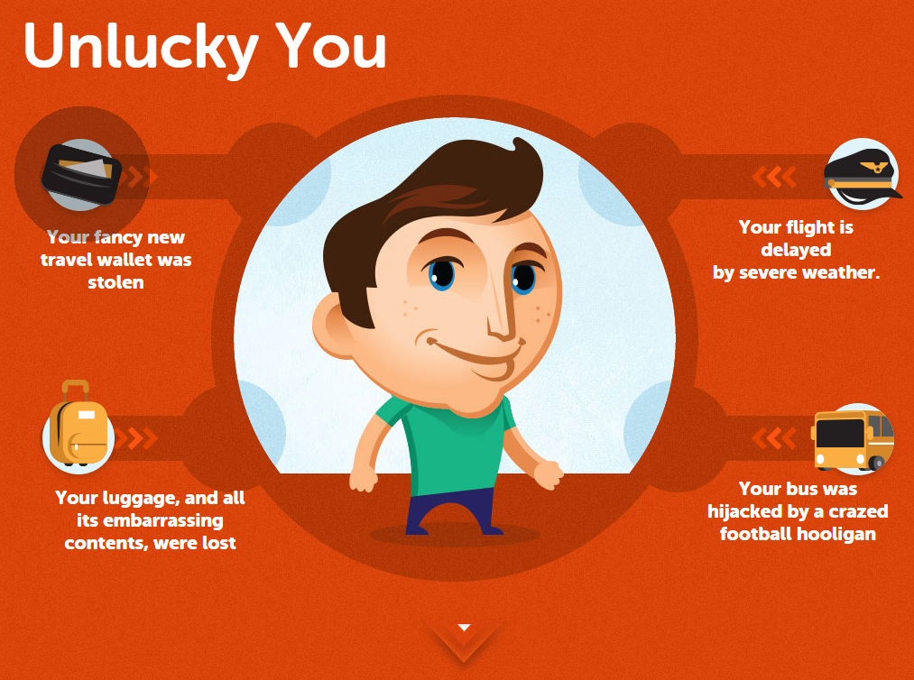
Notes:
28
youGo/unlucky explanation – Visual/Code (Choice #1)

Slide 29
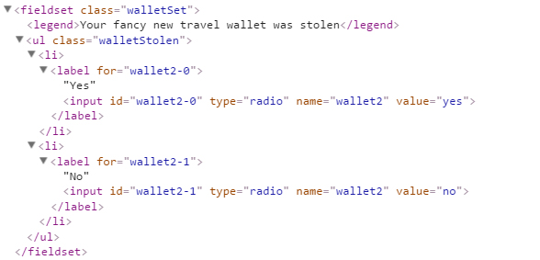
Notes:
29
youGo/unlucky explanation – Visual/Code (Choice #1)

Slide 30
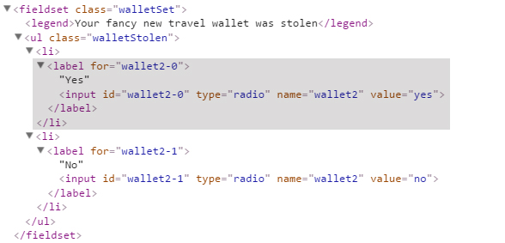
Notes:
30
youGo/unlucky explanation – Visual/Code (Choice #1) – switch on

Slide 31
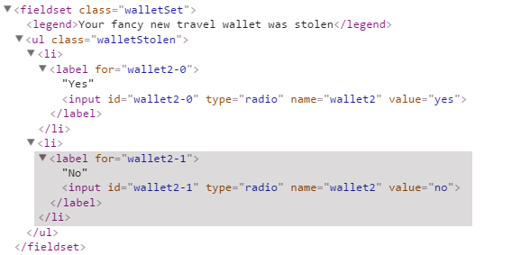
Notes:
31
youGo/unlucky explanation – Visual/Code (Choice #1) – switch off
Picture in the middle controlled via JS (lots of logic…Christmas tree logic!!!)
Back to the site -

Slide 32

http://www.rollcalltasteofamerica.com/
Notes:
CQ RollCall/Taste of America – a “friendly” contest among states for the best food, in the form of a NCAA bracket
http://www.rollcalltasteofamerica.com/
Go to site to display the whole bracket – 64 entries. How do I deal with this? No coding – sketching/drawing
https://www.flickr.com/photos/thewilsonproject/albums/72157626919870575
32

Slide 33
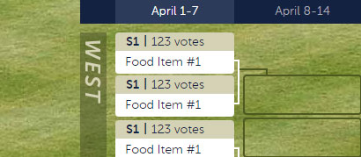
Notes:
One matchup - visual
33

Slide 34
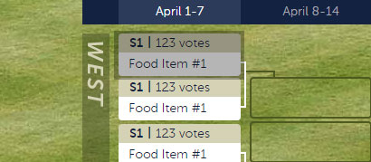
Notes:
One matchup – visual, take a look at a competitor
34

Slide 35
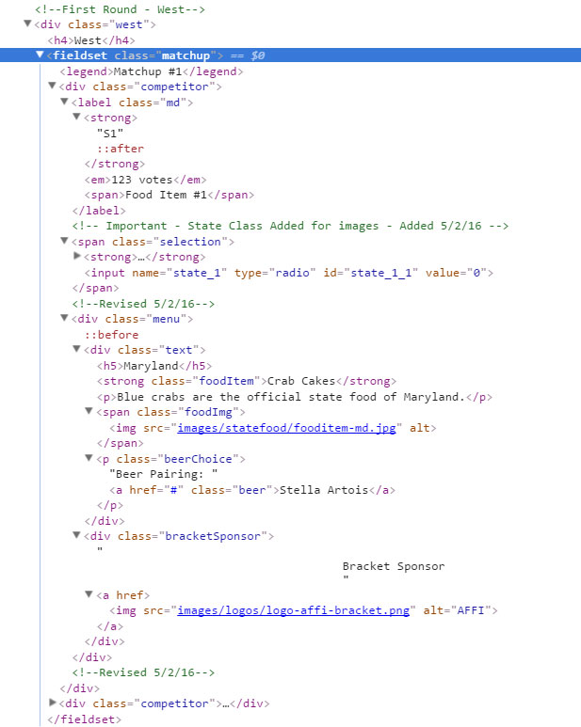
Notes:
One matchup – HTML code
Each fieldset contains two competitors
35

Slide 36
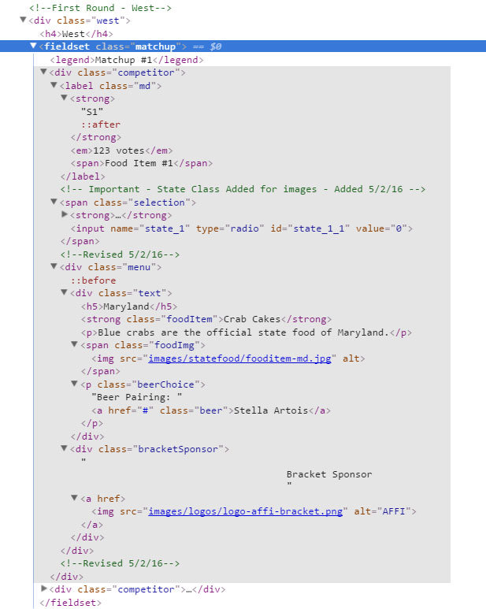
Notes:
One matchup – HTML code
Highlighted is code for one competitor
(Explanation of what is a fieldset/legend?)
36

Slide 37
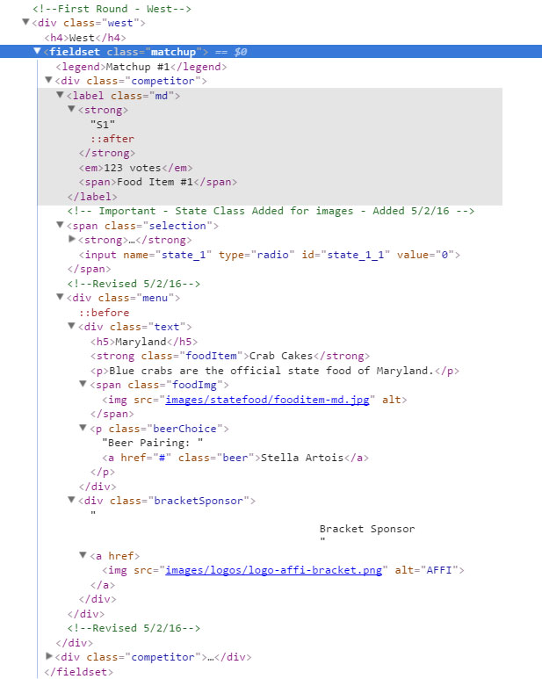
Notes:
One matchup – HTML code
What you see highlighted in both is the form label, the part which you interact (click), contains all the pertain information for describing the input
37

Slide 38
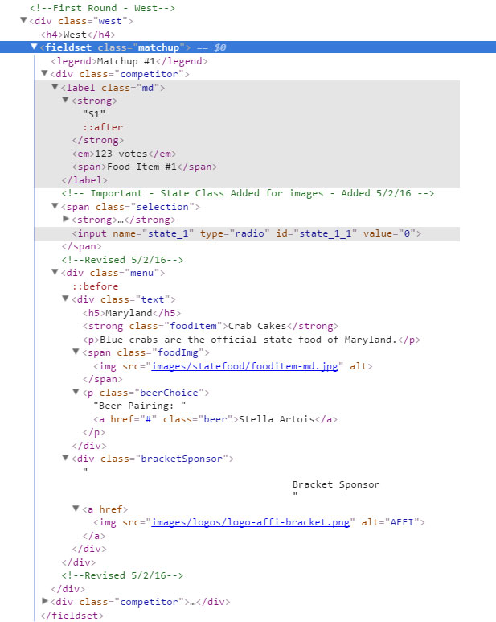
Notes:
One matchup – HTML code
Input is below, hidden unless no js
Go to (live) code example to show the working model
38

Slide 39
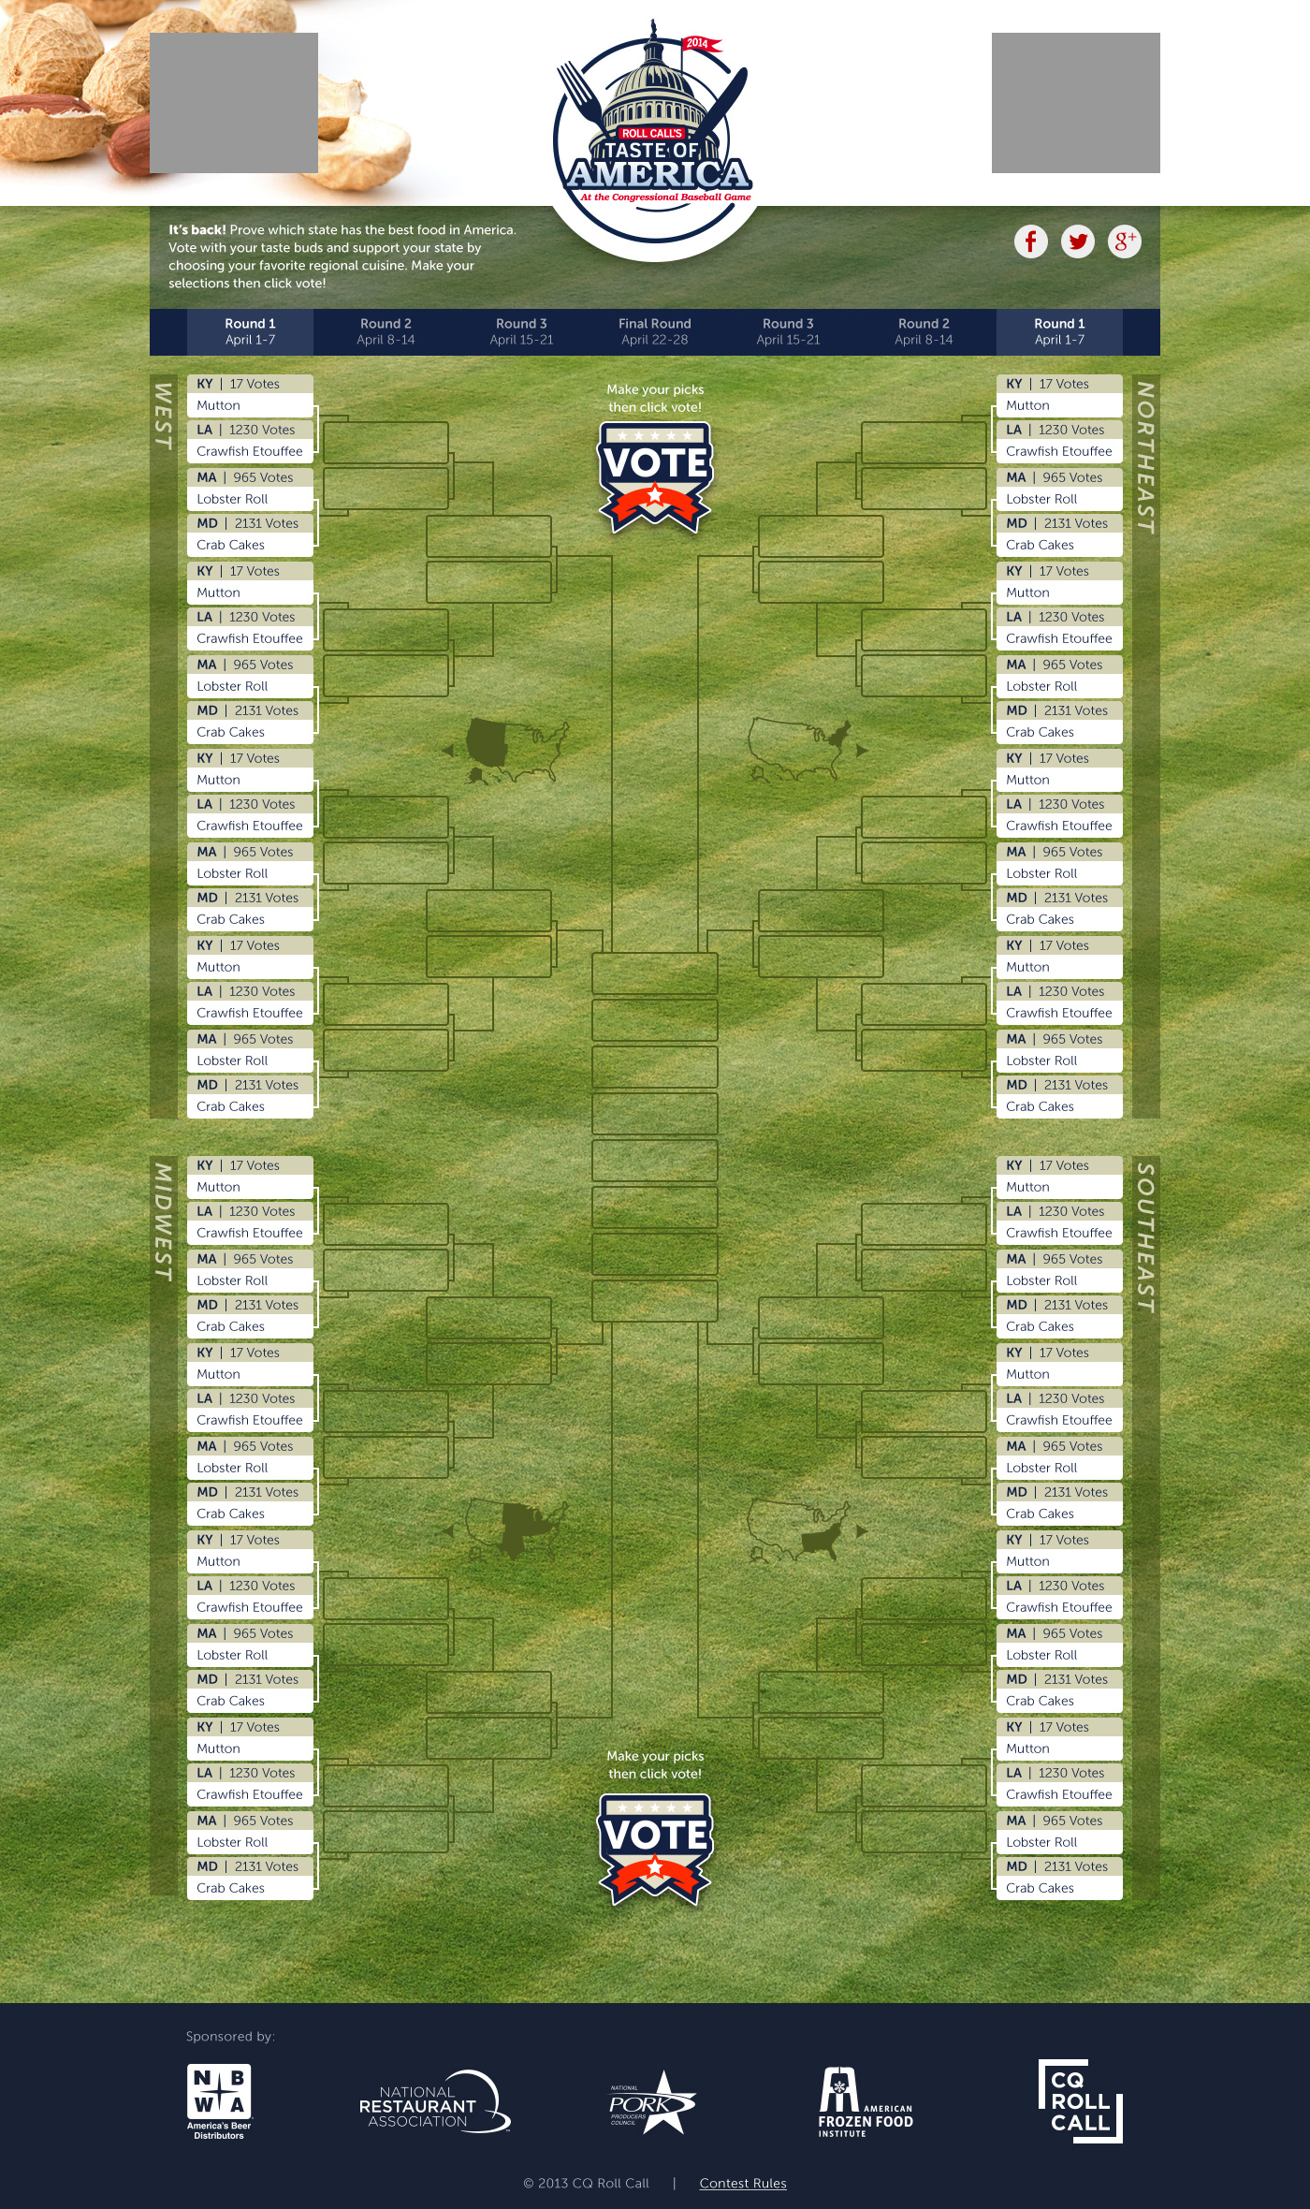

Slide 40
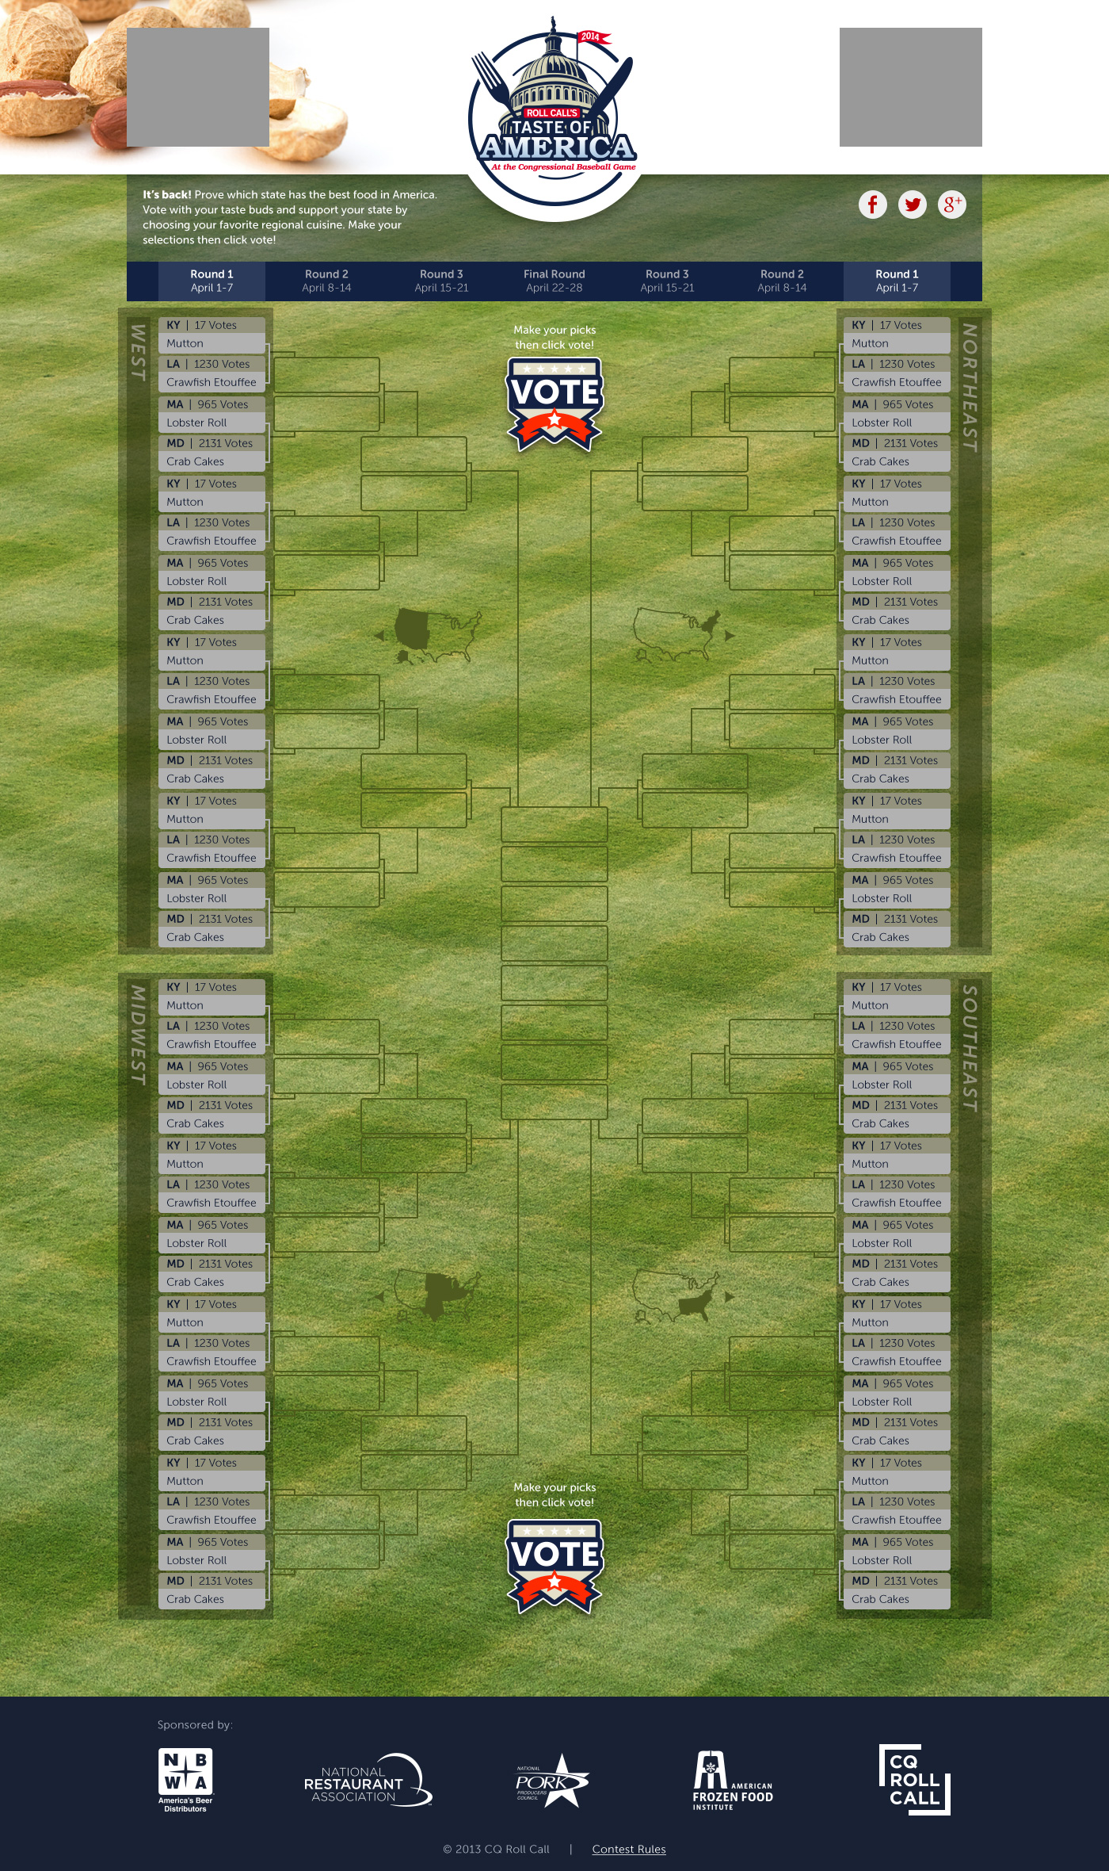

Slide 41
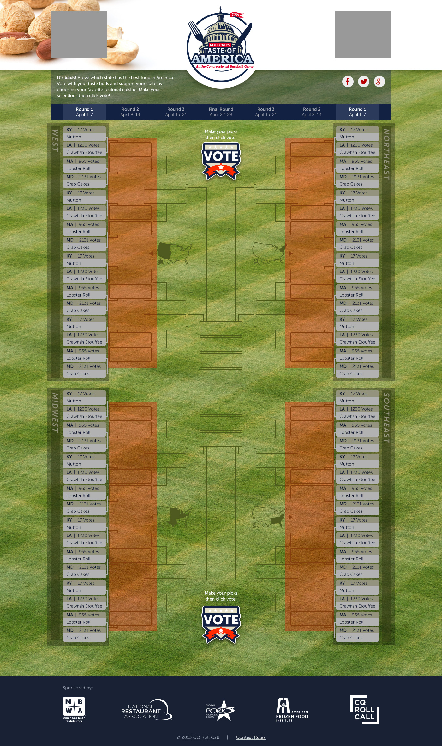

Slide 42
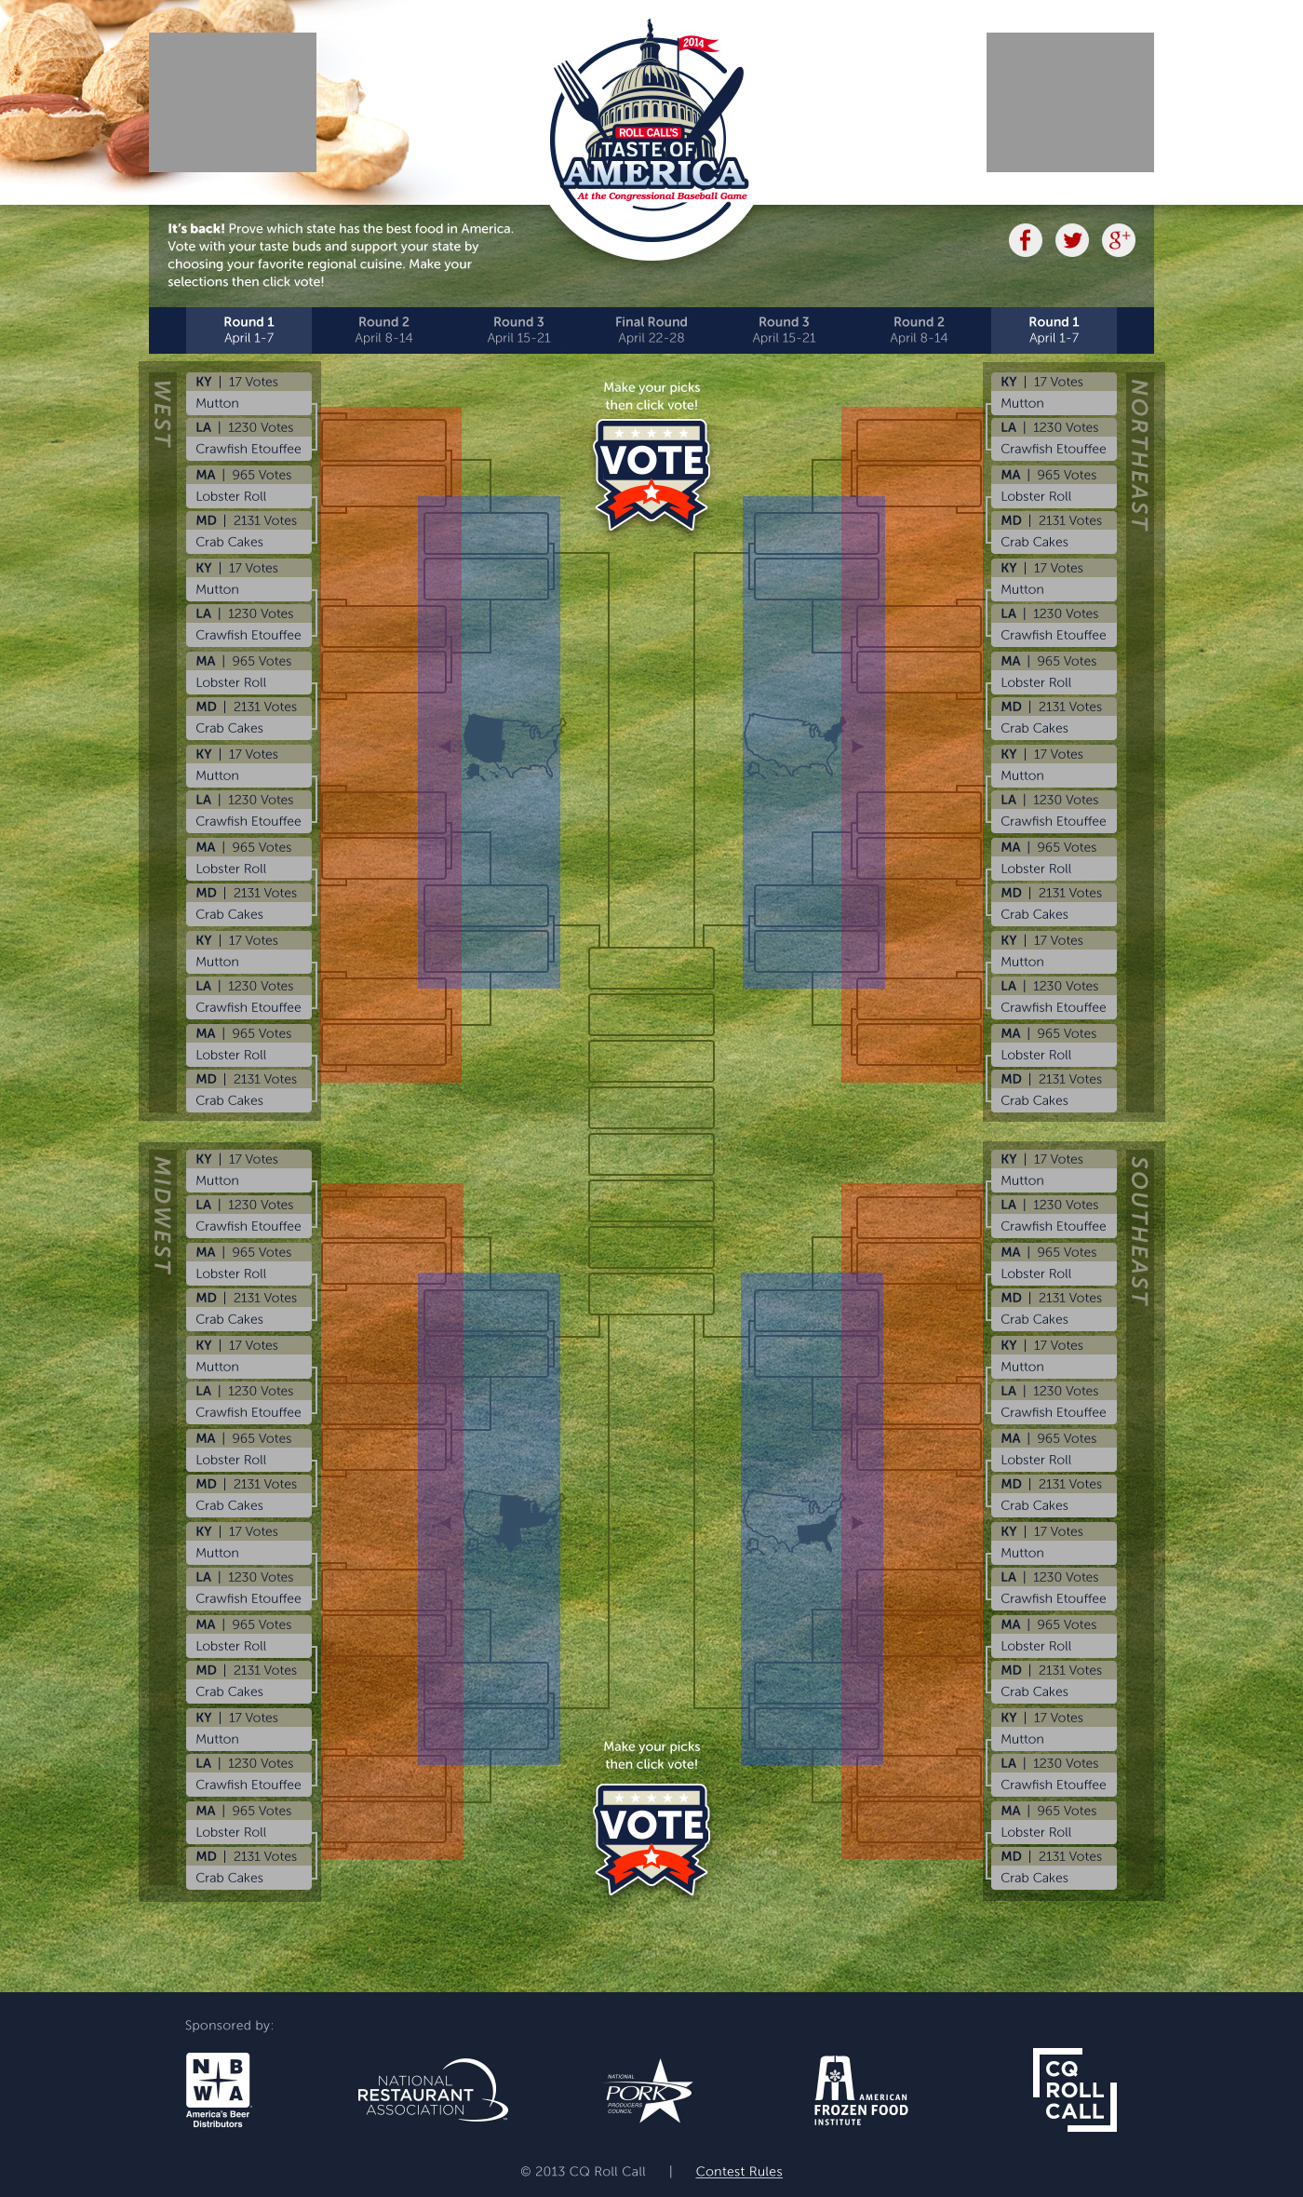

Slide 43
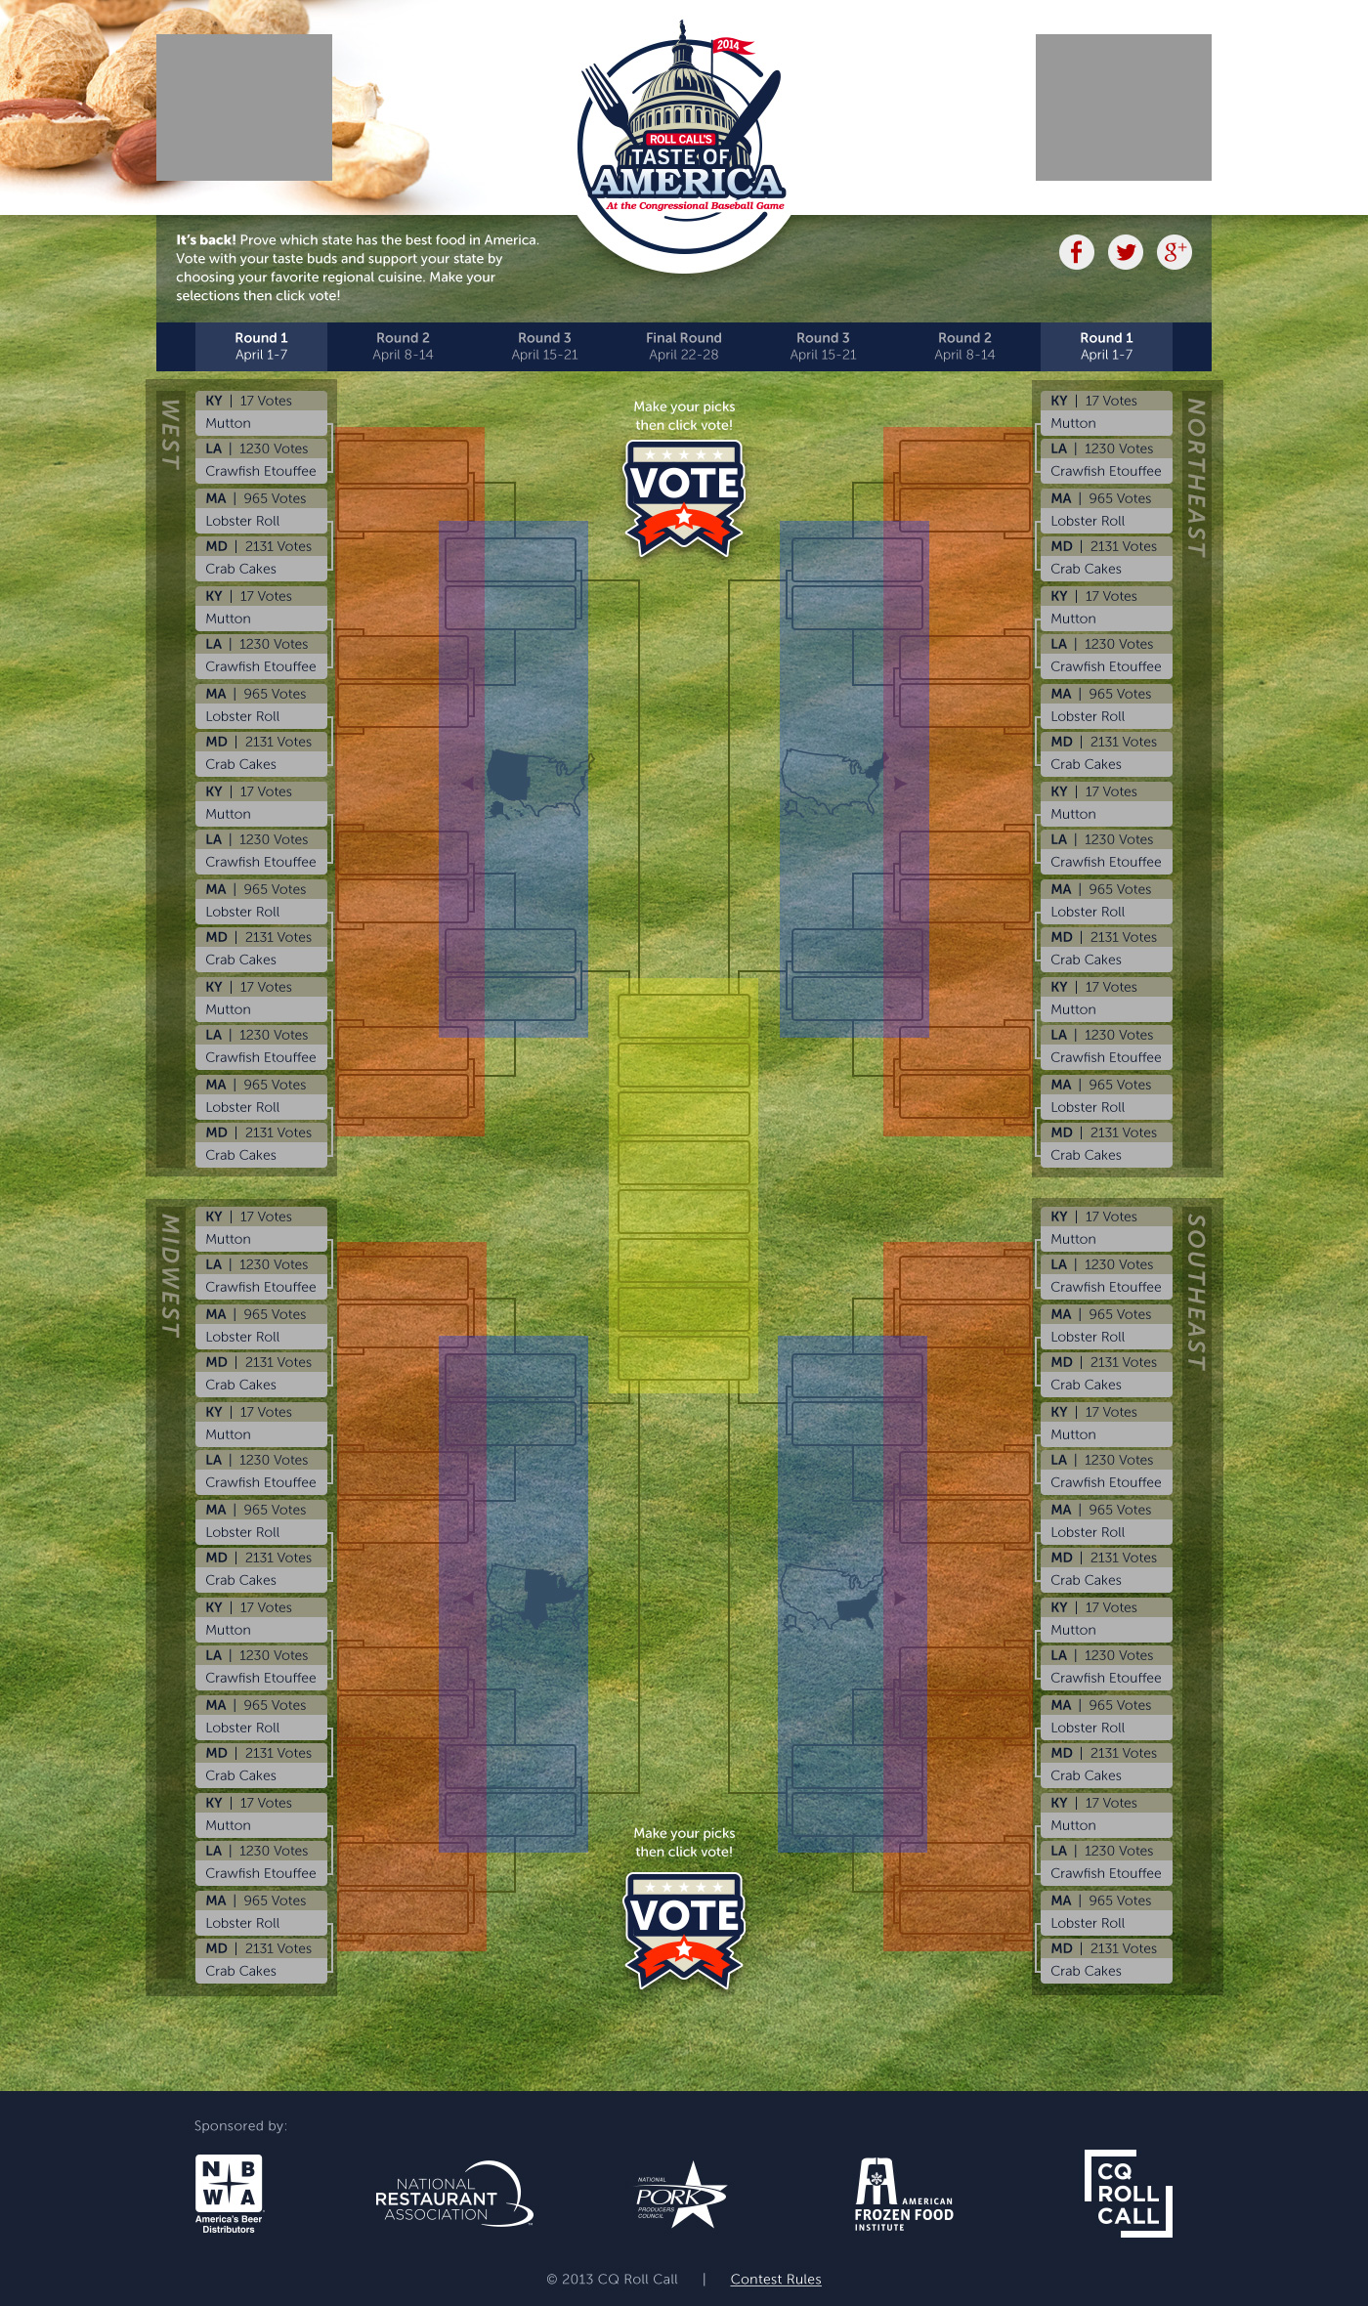

Slide 44
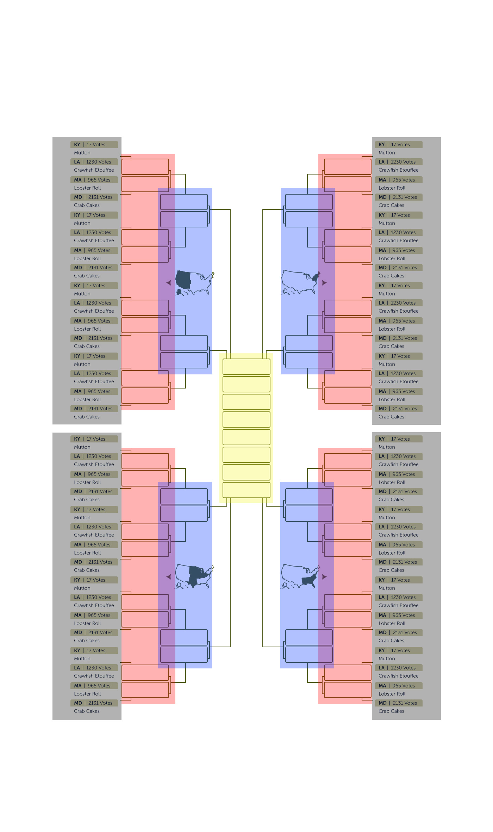

Slide 45


Slide 46
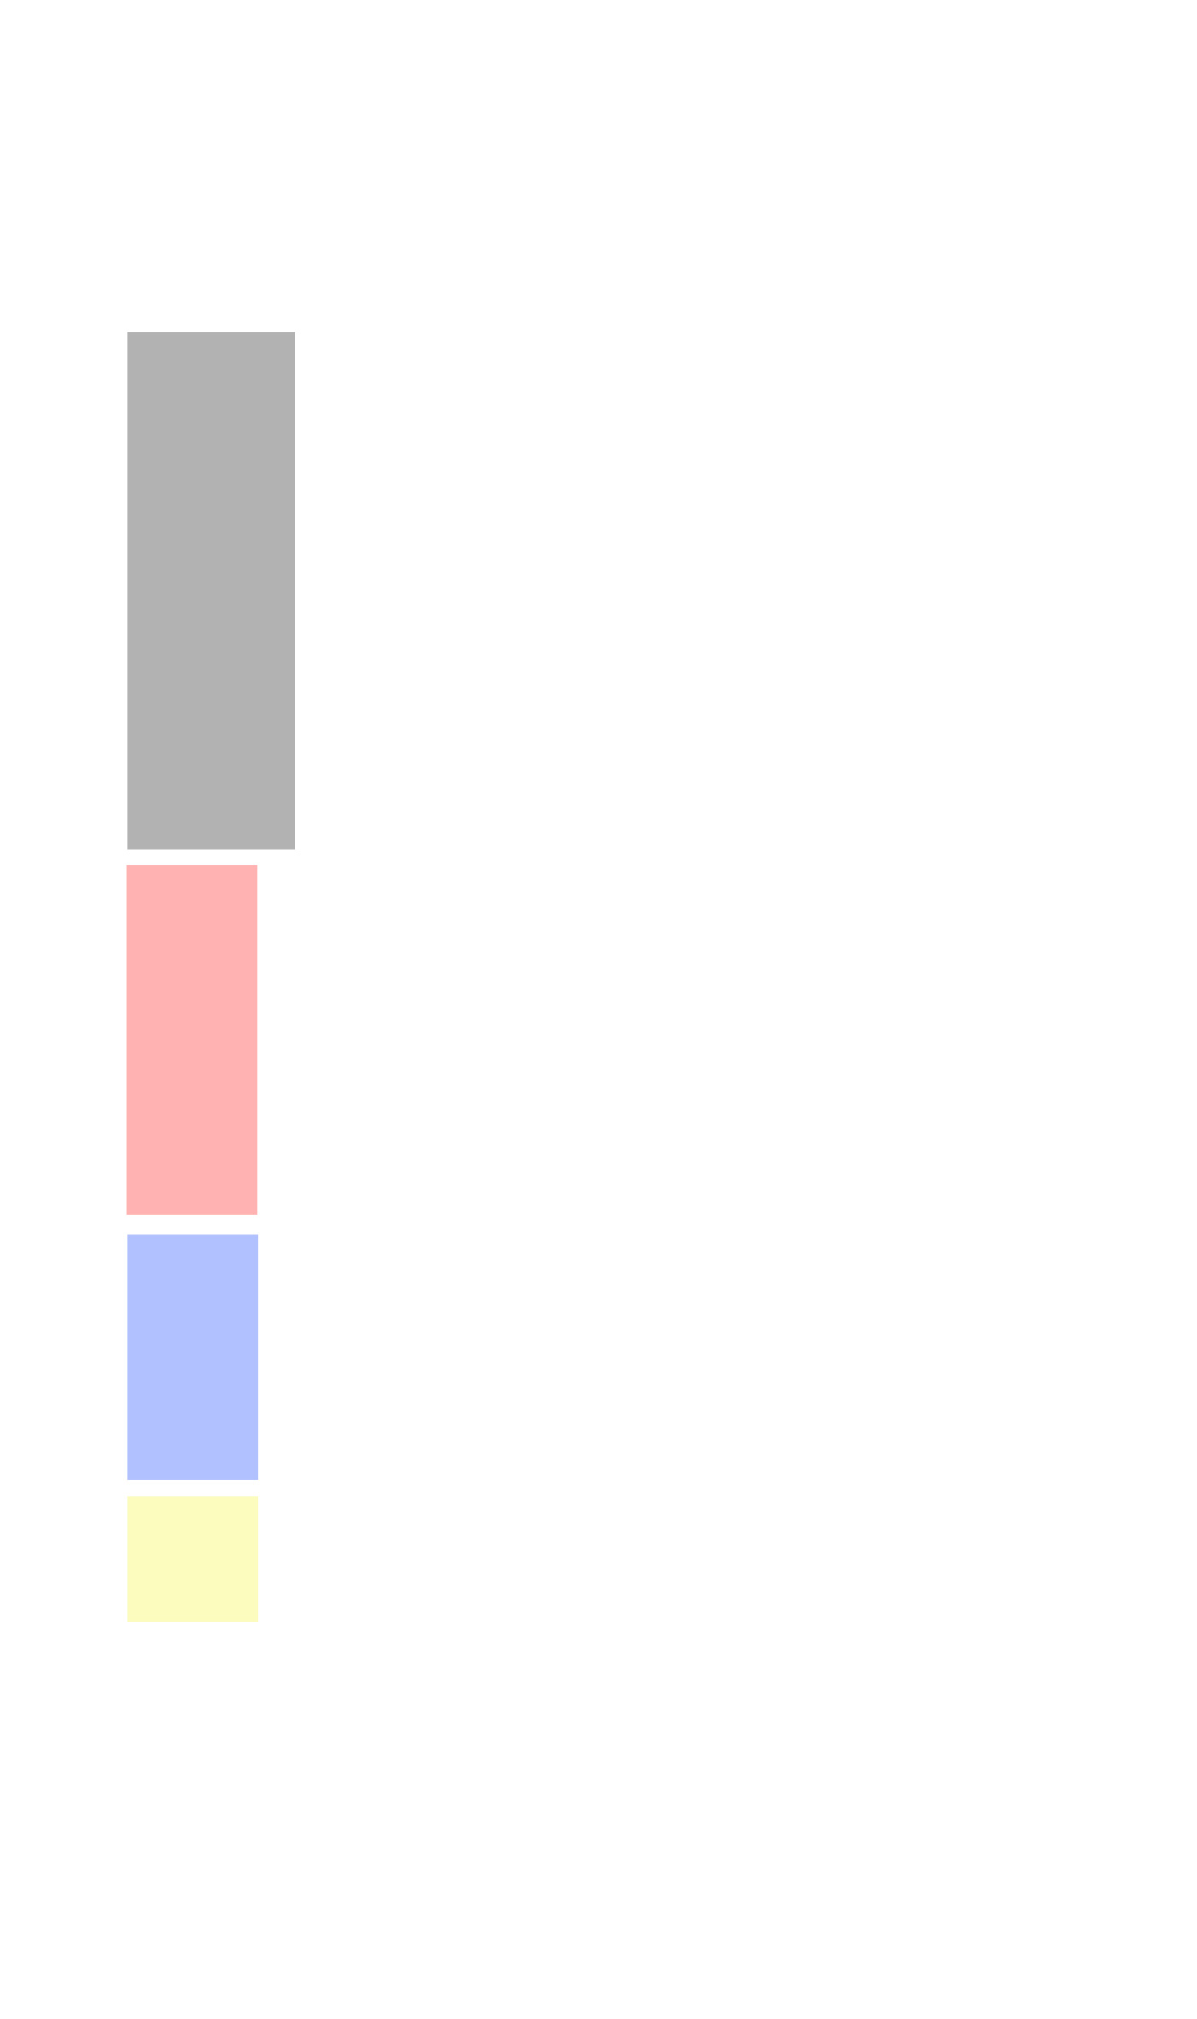

Slide 47
First Round
Second Round
Third Round
Final Round

Slide 48
Labels
are
your friends.
Notes:
Before going further – 1) explain what labels are and 2) what is that difference between placeholder and labels (and why that is important)
48

Slide 49

Labels
are
your friends.
Notes:
Before going further –
explain what labels are
what is that difference between placeholder and labels (and why that is important)
Touch area/mobile, a11y
Language
49

Slide 50
Explanation of touch area (Luke W) and a11y practices
Notes:
Touch area (Luke W, Apple “44” rule), a11y practices
50

Slide 51

Good copywriting is very important.
Notes:
Diversion – side note about good writing for labels (copywriting)
51

Slide 52
Buena redacción es muy importante.
Notes:
Diversion – side note about good writing for labels (copywriting) – foreign language mention
Examples –
Polish - http://www.mondial-assistance.pl/content/23/pl/oblicz-skladke-ubezpieczenia-turystycznego.html
Romanian - https://www.mondial-assistance.ro/content/23/ro/asigurare-calatorie-achizitie-online
Greek - http://www.mondial-assistance.gr/content/23/el/protasi
Hungarian - https://www.mondial-assistance.hu/content/23/hu/biztositas-kalkulator
52

Slide 53
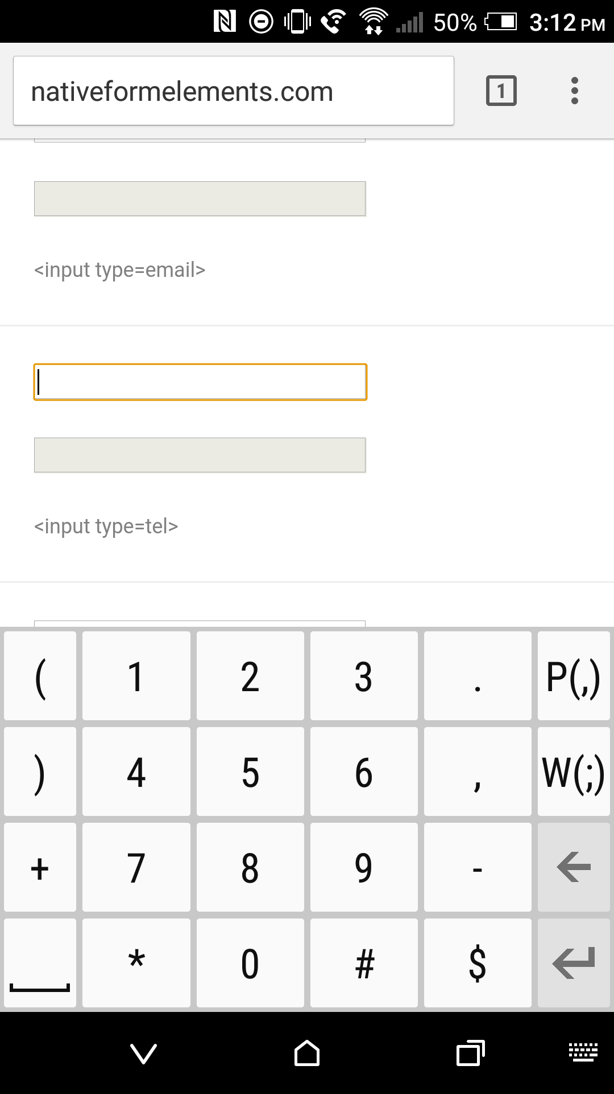
input type=“tel”

Slide 54
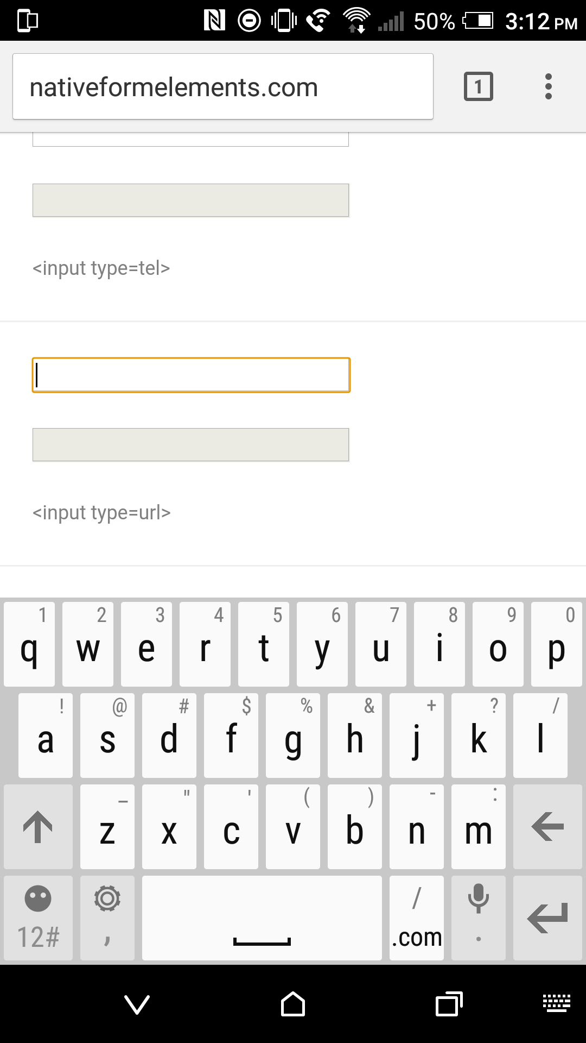
input type=“url”

Slide 55
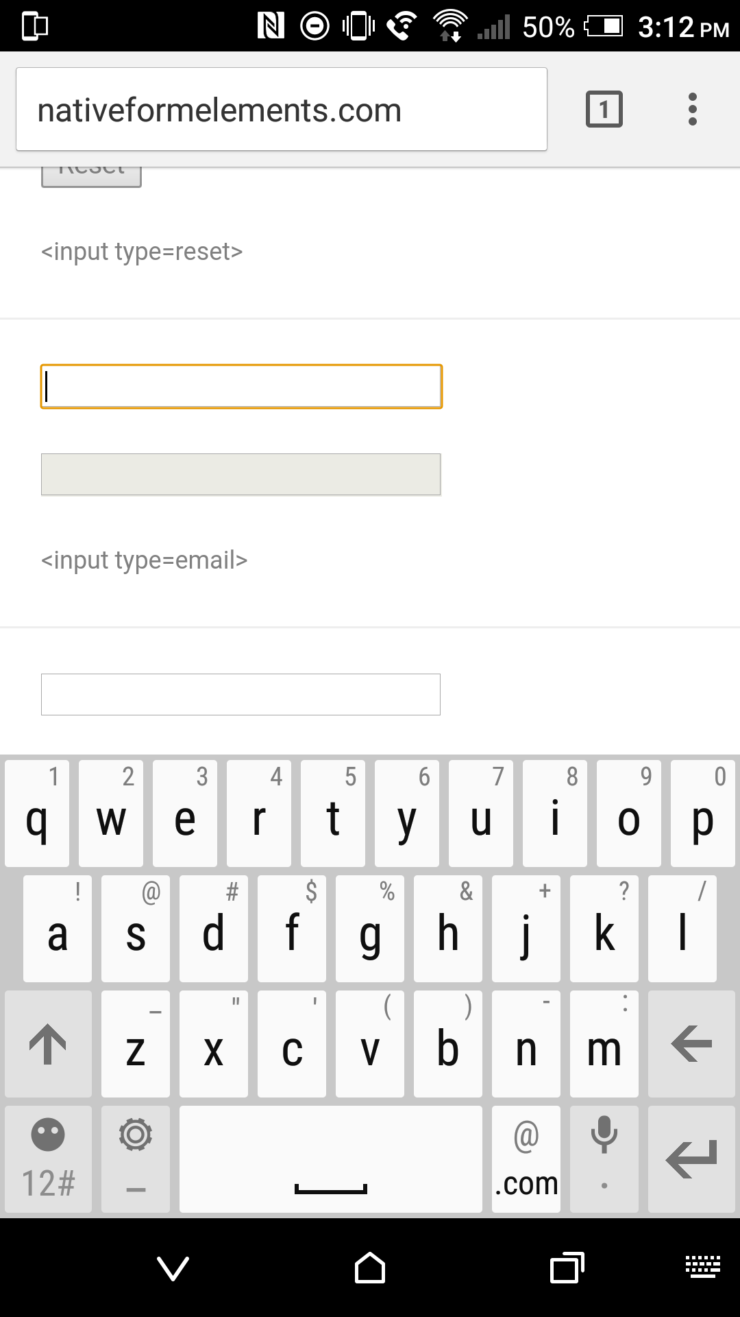
input type=“email”

Slide 56
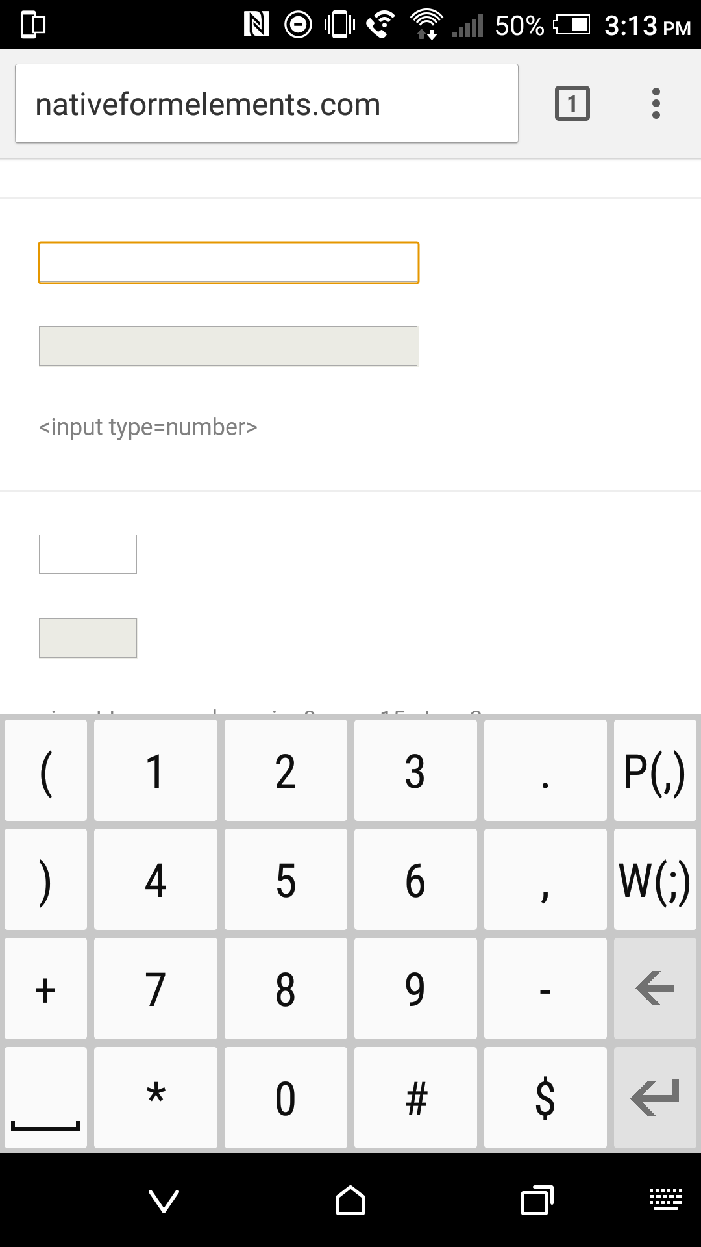
input type=“number”

Slide 57
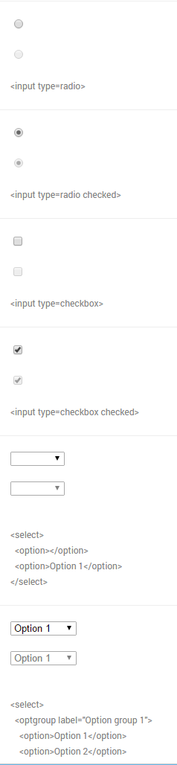
Chrome
Windows 10
Notes:
Differences of form UI’s among browsers/platforms
57

Slide 58
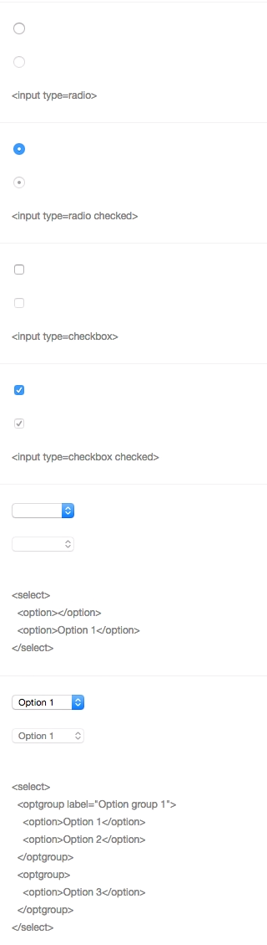
Chrome
Windows 10
Chrome
Yosemite
Notes:
Differences of form UI’s among browsers/platforms
58

Slide 59
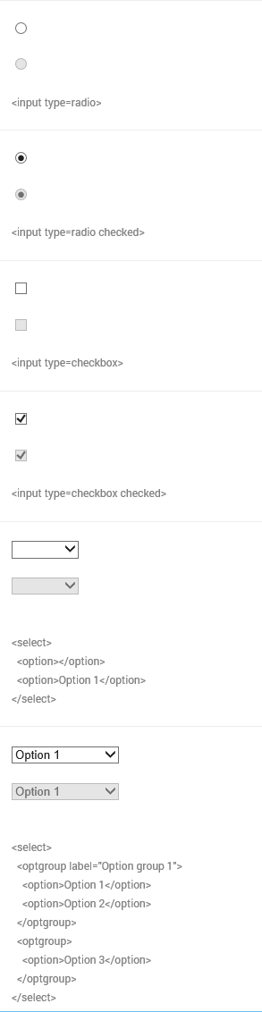
Chrome
Windows 10
Chrome
Yosemite
IE 11
Windows 10
Notes:
Differences of form UI’s among browsers/platforms
59

Slide 60
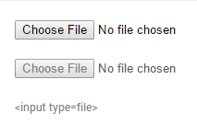
File Input
(Chrome/Firefox/Safari)
Notes:
Differences of form UI’s among browsers/platforms (mobile)
60

Slide 61
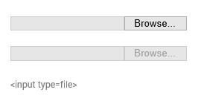
File Input
(Chrome/Firefox/Safari)
File Input
(IE/Edge)
Notes:
Differences of form UI’s among browsers/platforms (mobile)
61

Slide 62
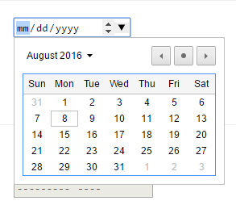
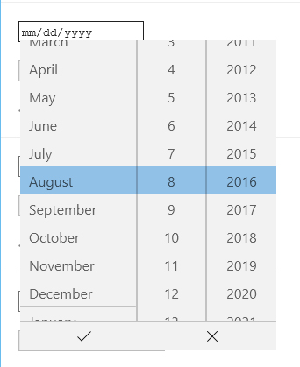
Chrome
Windows 10
Edge
Windows 10
Notes:
Another example – Date input (different look/functionality/UI) – Desktop
Go to nativeformelements.com for brief demo
62

Slide 63
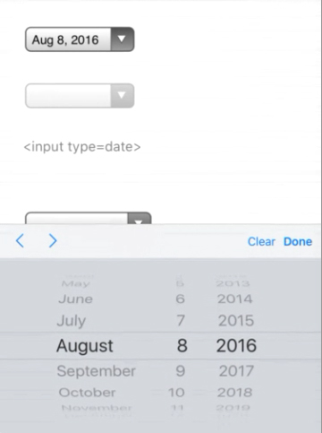
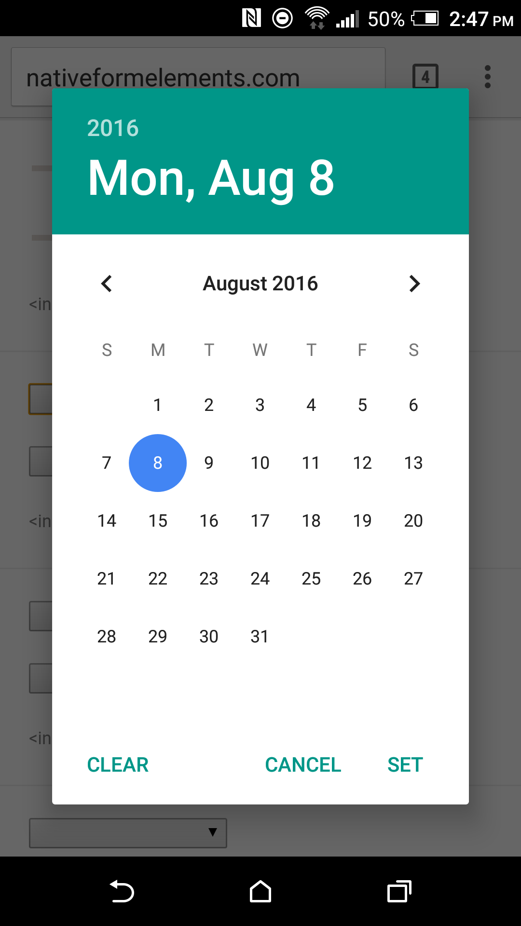
iPhone 6S Plus
iOS 9
HTC One M8
Android Marshmellow (6)
Notes:
Another example – Date input (different look/functionality/UI) - Mobile
63

Slide 64
The hardest thing
[and the easiest to misunderstand]
for people who work with HTML is that it’s not a visual language.
Notes:
Why are HTML tags so important?
Tags are descriptions themselves, that are independent of rendering.
64

Slide 65
The hardest thing
[and the easiest to misunderstand]
for people who work with HTML is that it’s not a visual language.
It’s an information language.
Notes:
Why are HTML tags so important?
Tags are descriptions themselves, that are independent of rendering.
Detailed explanation – refer to divs/spans
The end point being that
65

Slide 66
What is the need for CSS?

Slide 67
To enhance,
Not reproduce
native UI
Notes:
Explanation
GEICO Story (2008-09)
67

Slide 68
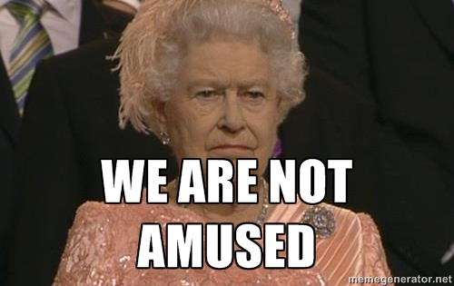

Slide 69
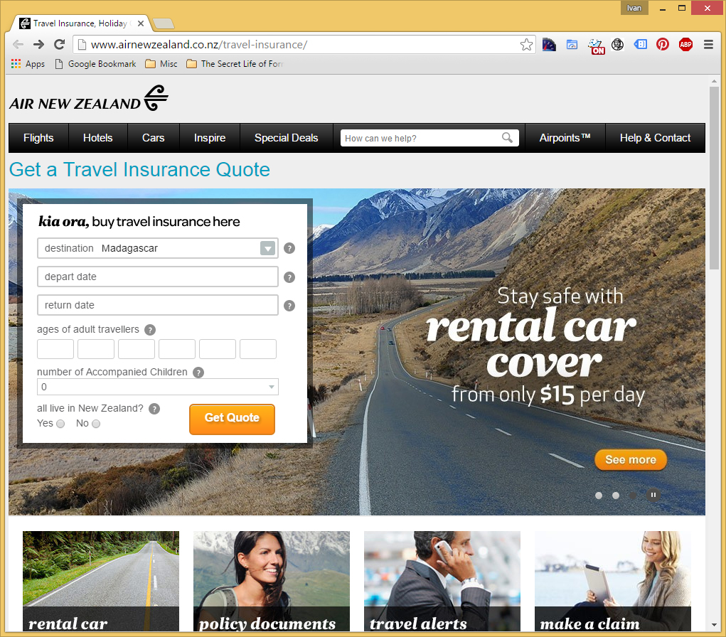
Notes:
Start story on adding grid from Air NZ to landing page
http://www.airnewzealand.co.nz/travel-insurance/
69

Slide 70
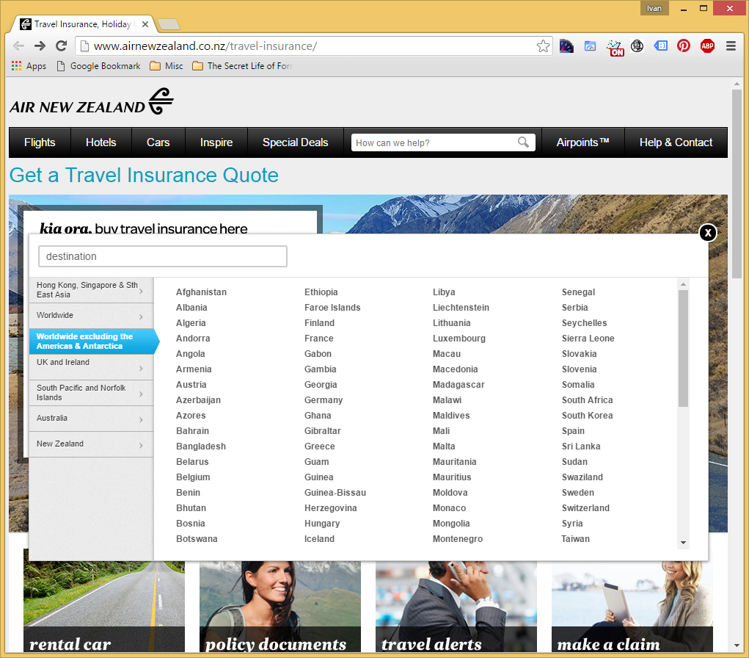

Slide 71
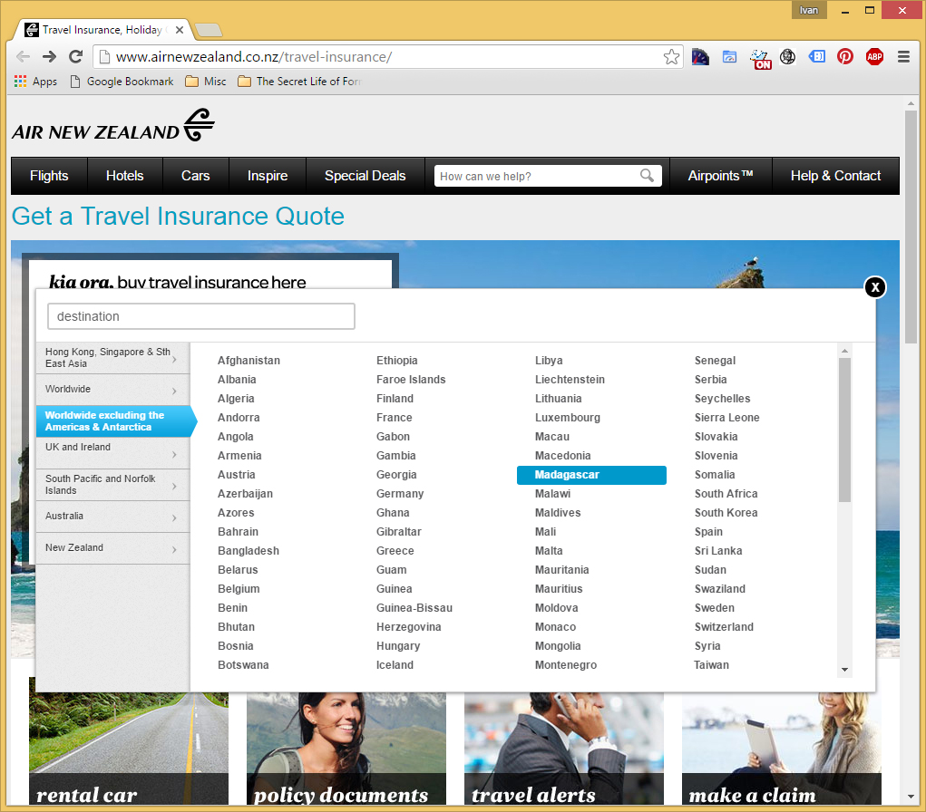

Slide 72
Notes:
The problem: is the client insisted that we added the grid to our new (responsive) purchase process. But…
72

Slide 73
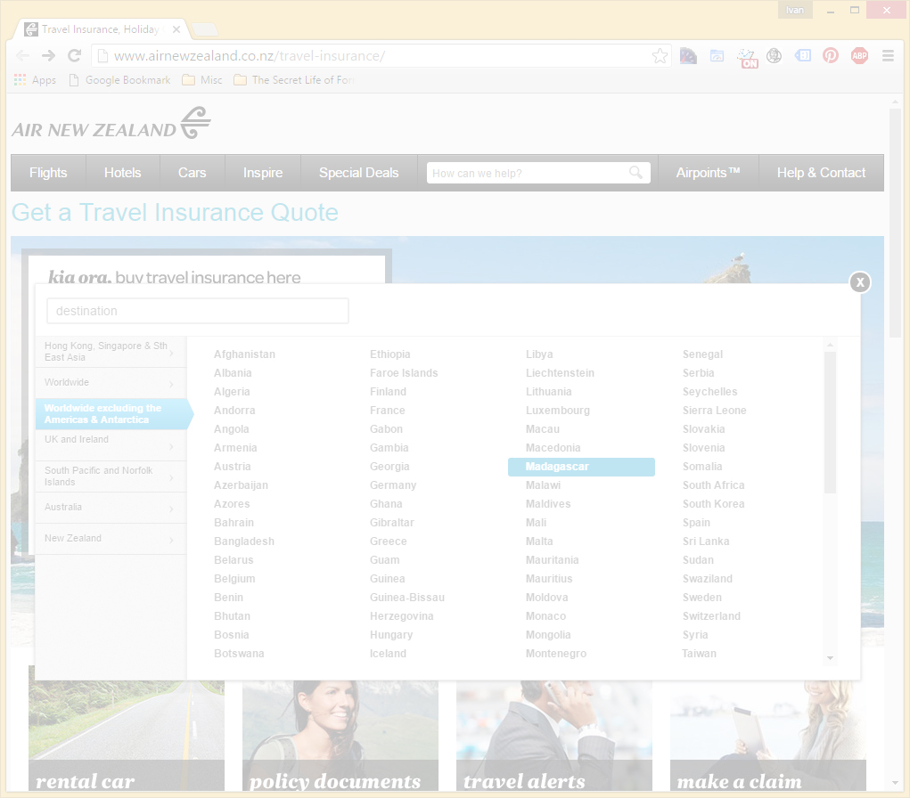
Not Responsive
Notes:
Yup.
73

Slide 74

Notes:
Solved problem with two prong/server page approach – one desktop/one mobile. Which is an viable option (see McGrane/adaptive solutions). But at the time, it had hiccups (serving wrong page, etc.). Not a mess but not an ideal (responsive) solution.
74

Slide 75
What if?
Notes:
If I had a chance, what would I do…
So I wrote some notes…
75

Slide 76
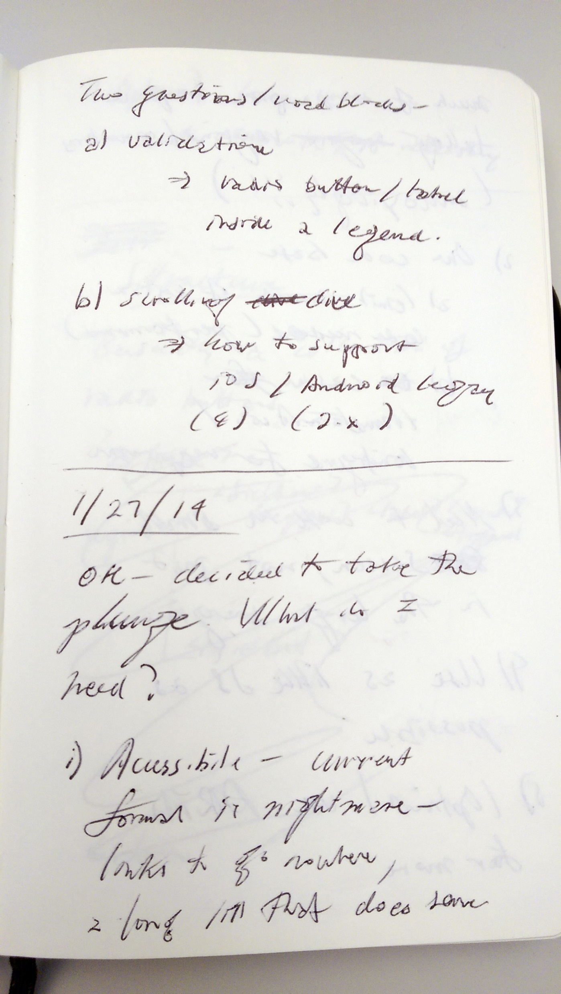

Notes:
First thing, change the codebase (responsive/reduced JS/a11y?)
Allowed for direct data input (no JS)
Single code base (responsive)
A11y???
76

Slide 77

Notes:
Going back to the base – information language
77

Slide 78


Slide 79


Slide 80


Slide 81


Slide 82

Notes:
82

Slide 83


Slide 84

Notes:
No JS in data entry – used for display/toggle
84

Slide 85
.ui-countryselector input[type="radio"] + label ~ div.columns { overflow: hidden; float: none; position: absolute; clip: rect(0,0,0,0); width: 100%; height: 0; margin: 0; padding: 0; }
Notes:
85

Slide 86
.ui-countryselector input[type="radio"] + label ~ div.columns { overflow: hidden; float: none; position: absolute; clip: rect(0,0,0,0); width: 100%; height: 0; margin: 0; padding: 0; }

Slide 87
.ui-countryselector input[type="radio"] + label ~ div.columns { overflow: auto; }
Notes:
87

Slide 88

.ui-countryselector input[type="radio"]:checked + label ~ div.columns { float: left; height: 384px; }
Notes:
Note – hard to do due to bugs. Adjacent bug in both iOS (“+” didn’t work) and Android (needed fix). Thankfully, fixed in more recent versions.
88

Slide 89
Few bugs exists when starting out two years ago. CSS/Adjacent Selector – with early versions of Android (<4.2) and iOS (7??) to a lesser degree
But all have disappeared.
Notes:
I found out during QA testing and was able to remove or work around some of the barriers.
89

Slide 90
Few bugs exists when starting out two years ago. CSS/Adjacent Selector – with early versions of Android (<4.2) and iOS (7??) to a lesser degree
But all have disappeared.
Thankfully!
Notes:
I found out during QA testing and was able to remove or work around some of the barriers.
90

Slide 91

Test!
Notes:
No excuse for not testing – getting problems out of the way. For the initial work, even had to test for Android 2.3…But the way, a moment of silence….
91

Slide 92
Memorial for Android 2.x testing

Slide 93
JS
/
ARIA

Slide 94
WAI-ARIA
WAI-ARIA (Web Accessibility Initiative – Accessible Rich Internet Applications) is a technical specification published by the World Wide Web Consortium (W3C) that specifies how to increase the accessibility of web pages, in particular, dynamic content and user interface components developed with Ajax, HTML, JavaScript and related technologies.
- Wikipedia (https://en.wikipedia.org/wiki/WAI-ARIA)
Notes:
Brief overview of history/explanation. Go further if needed – refer to W3C.
Need list of resources for audience
94

Slide 95
ARIA Landmark Roles
Notes:
Quick explanation of landmark roles. Using in combination with HTML (not duplicating)
95

Slide 96
aria-live = [off, polite, assertive, rude]
aria-describedby = [element id]
aria-labelledby = [element id]

Slide 97


Slide 98


Slide 99


Slide 100


Slide 101


Slide 102
Jet Lag/CallCodes Demo
(5mins max)

Slide 103
HTML
CSS
JS/ARIA
Notes:
Referencing Project Ottawa – three layers, translated into a) HTML, b) CSS, c) JS/ARIA
The FED toolbox for building experiences.
103

Slide 104
It’s not just about
making forms easier to use.

Slide 105
It’s not just about
making forms easier to use.
It’s also about
managing expectations.

Slide 106
Thank You!
Ivan Wilson
Innate
CSS Dev Conference
San Antonio, Texas
October 17-19, 2016
Notes:
106

